Slide 1
IT infrastructure
Subtopic 1.1.7.
Software infrastructure.

Slide 2
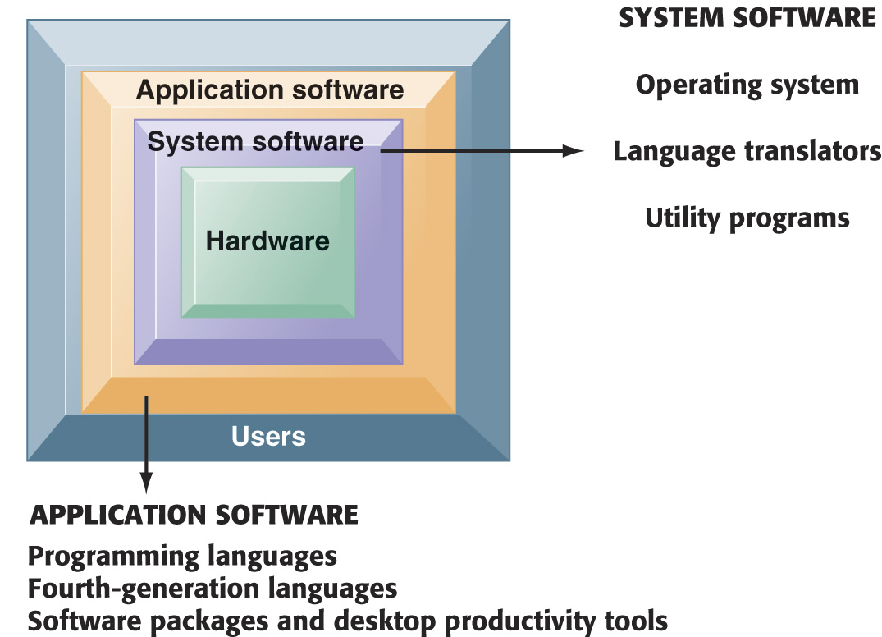
IT infrastructure
The Major Types of Software
The relationship among the system software, application software, and users can be illustrated by a series of nested boxes. System software—consisting of operating systems, language translators, and utility programs—controls access to the hardware. Application software, including programming languages and “fourth-generation” languages, must work through the system software to operate. The user interacts primarily with the application software.
*
* - http://bs.bnu.edu.cn/bkjx/kjxz/MIS/ppt/laudon_ess7_ch04.pdf
Notes:
You might ask students why a Microsoft application like Word cannot be installed on both PCs and Macintosh computers? Why is it that users are forced to buy different software application software for different devices? A part of the answer is the close interdependency of hardware, operating systems, and application software.
2

Slide 3
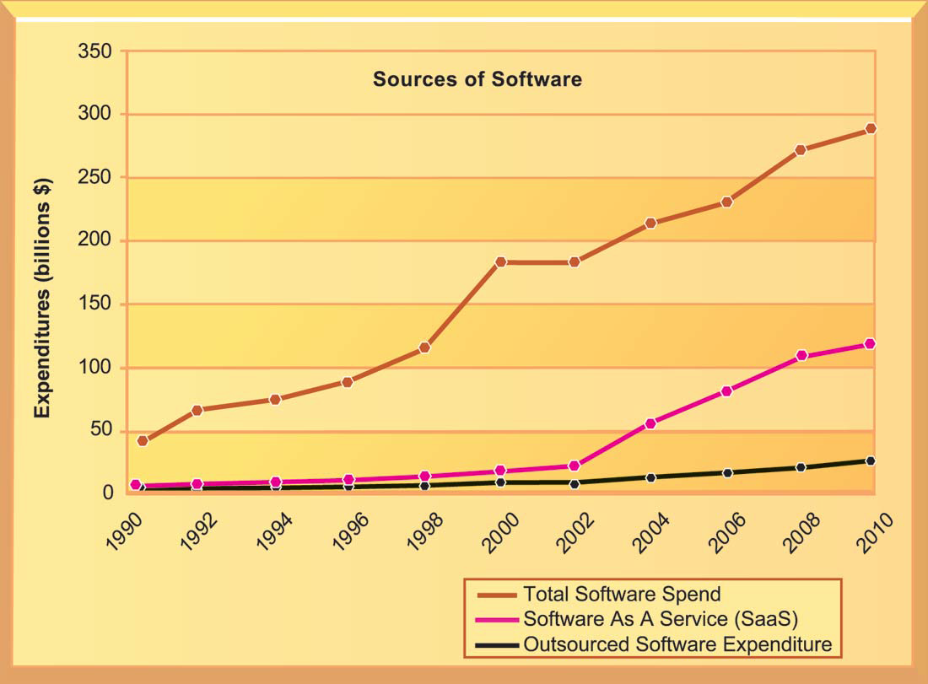
IT infrastructure
Changing sources of firm software
*
* - http://mail.tku.edu.tw/myday/teaching/1011/CSIM4C/1011CSIM4C05_Case_Study_IM.pdf

Slide 4
IT infrastructure
Operating System Software
The software that controls computer activities
GUIs and multitouch
PC operating systems
Windows (Windows 8)
Mac (OSX Lion)
UNIX
Linux (open source)
Mobile operating systems
Chrome, Android, iOS
Notes:
PC operating systems create the user interface, like Windows or Macintosh OS. This interface has evolved from a text command interface to a mouse-based graphical user interface to current touch screen interfaces found on some PCs and smartphones. Most students do not know their cell phone has an operating system. On the blackboard, make a list of the “resources” that a cell phone or smartphone has to manage. Managing these resources is one function of the operating system, along with creating the use interface.
4

Slide 5
IT infrastructure
Application Software and Desktop Productivity Tools
Fourth-generation languages
Software tools that enable end-users to develop software applications
Tend to be nonprocedural, may use natural languages
Notes:
Ask if any students are computer programmers? What languages did they use? What kinds of applications did they develop? Fourth generation languages today are more likely to be report generators and graphics tools for taking data from different sources and making attractive visual presentations of the data. Crystal Reports is the most widely used report generator www.crystalreports.com. You can visit this site during class to give students an idea of what report generators do.
5

Slide 6
IT infrastructure
Categories of Fourth-Generation Languages
Tool | Description | Example
PC software tools | General-purpose software packages for PCs | WordPerfect Microsoft Access
Query language | Languages for retrieving data stored in databases or files | SQL
Report generator | Specialized tools for creating highly customized reports | Crystal Reports
Graphics language | Display data from databases in graphic format | SAS Graph Systat
Application generator | Preprogrammed modules to generate entire applications | WebFOCUS QuickBase
Application software package | Software programs that eliminate need for custom, in-house software | Oracle PeopleSoft HCM mySAP ERP
Notes:
6

Slide 7
IT infrastructure
Application Software and Desktop Productivity Tools
Software packages and desktop productivity tools
Word processing software
Spreadsheet software
Data management software
Presentation graphics
Software suites
Web browsers
Notes:
Although Microsoft Office applications are found on more than 80% of the world’s billion computers, the news in this area is the growth of open source and free desktop applications. Although online on demand apps like Google Apps, StarOffice, are growing in market acceptance, most users continue to buy Microsoft software. Why do students think this is the case?
7

Slide 8
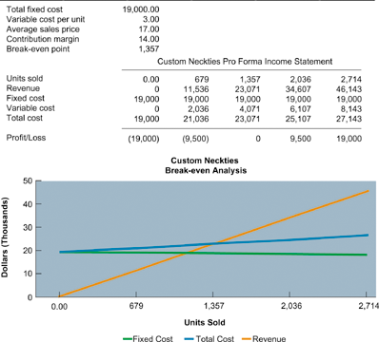
IT infrastructure
Spreadsheet Software
Spreadsheet software organizes data into columns and rows for analysis and manipulation. Contemporary spreadsheet software provides graphing abilities for a clear, visual representation of the data in the spreadsheets. This sample break-even analysis is represented as numbers in a spreadsheet as well as a line graph for easy interpretation.
Notes:
Ask how many students use spreadsheets on a regular, daily basis? How many have never used spreadsheet software? Ask the users to describe how they use the software, what kinds of reports have they produced? What are the advantages of this software when compared to older methods—like calculating things by hand! What are the drawbacks of this software that they have personally witnessed.
8

Slide 9
IT infrastructure
Software for the Web: Java and HTML
Java:
Operating system-independent, processor-independent, object-oriented programming language
Hypertext markup language (HTML):
Page description language for specifying how elements are placed on a Web page and for creating links to other pages and objects
HTML5
Next evolution of HTML
Enables multimedia embedding without 3rd party add-ons like Flash
Notes:
Java, and the Java Virtual Machine, is ubiquitous across the Web. It is useful because it allows developers to write an application once in Java, and then be assured it will work on any Java-enabled machine.
Many students probably do not know that you can see the HTML code of any Web page by the View/Page Source menu in Mozilla Firefox. You could demonstrate this during class.
9

Slide 10
IT infrastructure
Web Services
Web services:
Software components that exchange information with one another using universal Web communication standards and languages
XML (eXtensible Markup Language)
Foundation of Web services
Service oriented architecture (SOA)
Collection of services used to build an organization’s software systems
Notes:
Web services is an approach to building enterprise applications. Web services is a “messaging system” which allows diverse computing applications in a firm to communicate data with one another without extensive integration of the constituent applications (which tends to be very expensive). In a service-oriented architecture, various applications provide “services” (data) on request to other applications needing data. SOA is a major alternative to installing large scale enterprise systems.
Emphasize that SOA is a method of developing infrastructure using Web services with an eye toward creating applications that draw data from several underlying (usually older programs). All programs are built or redesigned to provide certain information (services) to all other programs. With SOA, developers incorporate each individual service into an application that successfully meets the needs of the organization.
10

Slide 11
IT infrastructure
Software Trends
Open source software
Linux, Apache
Cloud-based software and tools
SaaS (software as a service)
Google Docs
Mashups
Zip Realty uses Google Maps and Zillow.com
Apps
Mobile apps
Notes:
Ask students to help you put together a list of really interesting software apps they have discovered or used in the last few months.
11

Slide 12
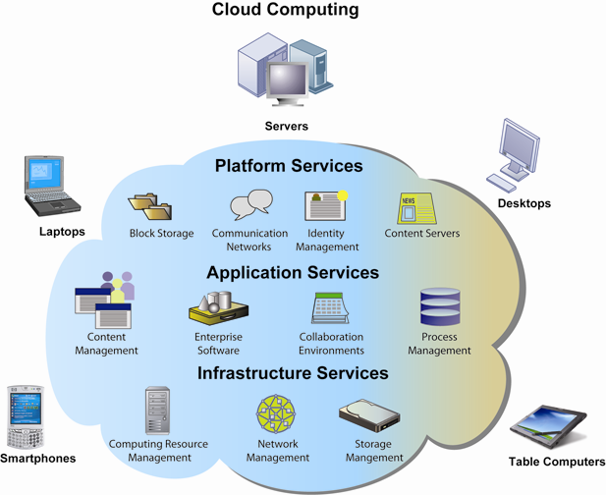
IT infrastructure
Cloud Computing Platform
In cloud computing, hard-ware and software capa-bilities are provided as services over the Internet. Businesses and employees have access to applicati-ons and IT infrastructure anywhere at any time using an Internet-con-nected device.
Notes:
The largest operators of cloud computing data centers are IBM, Oracle, HP, Apple, Google, and Amazon.
12

