Slide 1
IT infrastructure
Subtopic 1.1.6 . Infrastructure of data processing center (DPC)

Slide 2
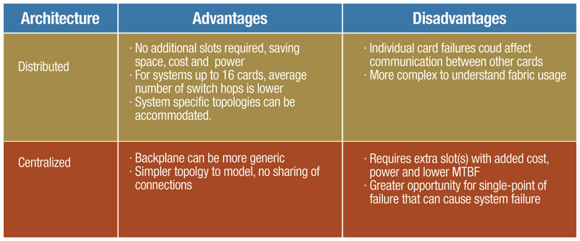
IT infrastructure
http://archive.cotsjournalonline.com/articles/view/101273
Some of the major advantages and disadvantages of centralized and distributed architectures.

Slide 3
IT infrastructure
Processing Center
https://steemit.com/technology/@ndnthor/what-is-a-data-processing-center
A Data Processing Center is the physical space where, in an organized way, a large number of computer and electronic equipment are stored in lockers, with the purpose of storing and processing digitized information from a private company, a public entity

Slide 4
IT infrastructure
Centralized Data Processing
https://slideplayer.com/slide/1574754/

Slide 5
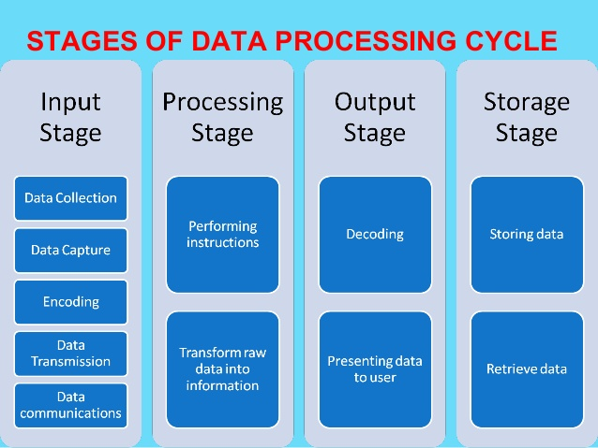
IT infrastructure
https://peda.net/kenya/ass/subjects2/computer-studies/form-3/data-processing/dpc2

Slide 6
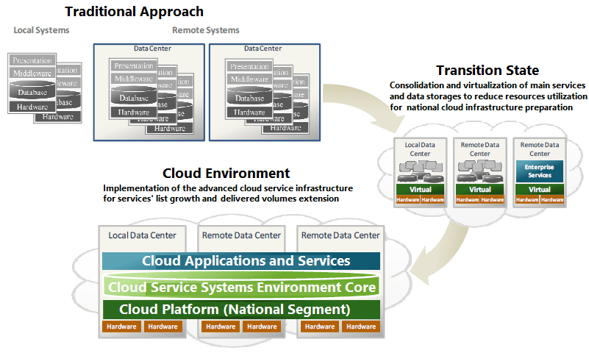
IT infrastructure
Centralized Data Processing
https://www.researchgate.net/figure/Consolidated-data-processing-centers-forming-the-base-of-common-cloud-informational_fig2_311780444

Slide 7
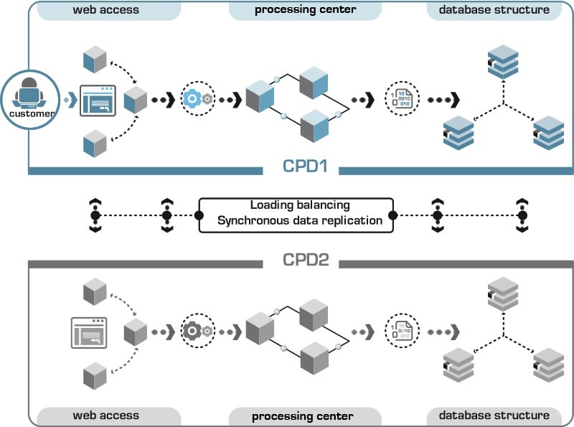
IT infrastructure
https://www.imagenesmi.com/im%C3%A1genes/data-center-single-line-diagram-1d.html

