Slide 1
IT infrastructure
Subtopic 1.1.5 Data storage infrastructure

Slide 2
IT infrastructure
https://prohoster.info/kompaniya/blog/arenda-virtualnogo-servera-windows-s-vps-kvm-pozvolit-stabilno-zarabatyvat-i-zashhitit-tsennye-dannye

Slide 3
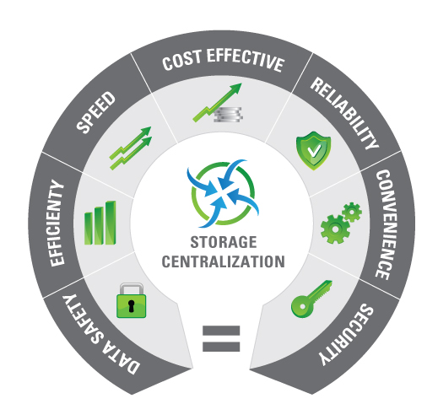
IT infrastructure
https://www.acutesoft.com/it-services/it-infrastructure-services/storage-management/
Disk Storage Systems: Disk Array (Enterprise SAN), Modular Array (entry level SAN), IP SAN, DAS/J-BOD, Storage Blades, and NAS solutions.
Disk Backup Systems: Virtual Library Systems, D2D Backup, Removable Disks.
Tape Drives & Blades: LTO, DAT, and Simple to fully Automated Tape Libraries.
Backup and Archival Solutions
Virtualized and Unified Storage Solutions.
Disaster Recovery and Business Continuity Solutions.

Slide 4
IT infrastructure
There are various forms of storage networking, including:
- network-attached storage (NAS)
- storage area networks (SANs).
Notes:
Storage networking is a field that borrows from many disciplines and technology categories to help data flow across a network to the various systems that make a business tick.
Essentially, they all deliver data services from external storage systems across a network and allow multiple users or devices to share storage capacity.

Slide 5
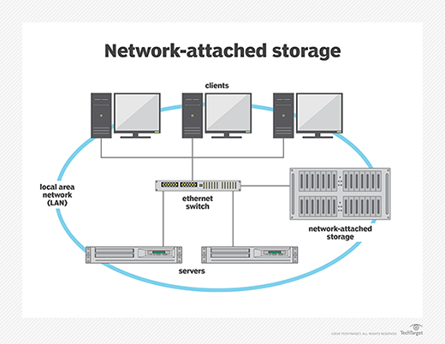
IT infrastructure
http://cctvcoimbatore.co.in/index.php?route=product/product&product_id=79
Notes:
NAS systems or appliances are specifically designed to provide file-level storage over a network using traditional Ethernet-based networks. Housing one or more drives, NAS devices enable multiple devices to access, save, and share files. Supported protocols often include Network File System (NFS) and Server Message Block (SMB). NAS systems can range from compact appliances for small office/home offices (SOHO) to enterprise-grade arrays.

Slide 6
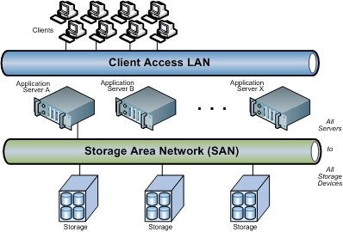
IT infrastructure
Storage area network (SAN)
https://www.snia.org/education/storage_networking_primer/san/what_san
SANs are often used to:
Improve application availability
Enhance application performance
Increase storage utilization and effectiveness and improve data protection and security.
SANs also typically play an important role in an organization's Business Continuity Management (BCM) activities.
Notes:
A SAN is its own network of storage systems that provides block-level storage services to networked devices. SAN configurations are as varied as the organizations that use them, due to their application requirements, storage utilization objectives and countless other factors, but they all generally feature a SAN fabric containing switches that connect servers or host systems to storage via host bus adapters (HBAs).

Slide 7
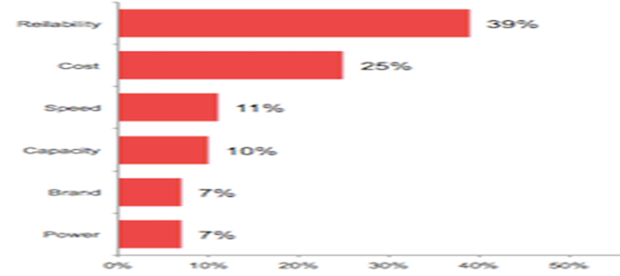
IT infrastructure
Importance of data storage characteristics
Notes:
While data storage reliability is an important goal, no technology is perfect. There will always be a need to maintain accurate and easily accessible backups.
The ability of a data storage system to operate for long periods of time without failure reflects the number and quality of components and directly affects the value and marketability of the system. Selection of components with very long MTBF (mean time between failure) ratings can increase probable operating life of a storage system, but usually at increased cost. Higher levels of redundancy, such as additional spare controllers, buses, and/or storage devices may also result in higher system cost.
Reliability is more important than cost when it comes to making data storage purchasing decisions, a new study has indicated.
Research from Western Digital found that 39 per cent of IT decision makers believe reliability is the most important factor regarding data storage purchasing decisions, in comparison to the 25 per cent who cite cost.

