Slide 1
IT infrastructure
Subtopic 1.1.4.
Evolution of IT- infrastructure.

Slide 2
IT infrastructure
EVOLUTION OF IT INFRASTRUCTURE: 1950–2019.
The IT infrastructure today is an outgrowth of over 70 years of evolution in computing platforms.
We have identified FIVE stages in this evolution:
ELECTRONIC ACCOUNTING MACHINE ERA: 1930–1950;
GENERAL-PURPOSE MAINFRAME AND MINICOMPUTER ERA: 1959 TO PRESENT;
PERSONAL COMPUTER ERA: (1981 TO PRESENT);
CLIENT/SERVER ERA: (1983 TO PRESENT);
ENTERPRISE INTERNET COMPUTING ERA: (1992 TO PRESENT).

Slide 3
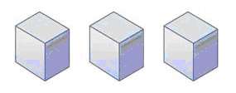
IT infrastructure
ELECTRONIC ACCOUNTING MACHINE ERA: 1930–1950.
The first era of business compu-
ting used specialized machines
that could sort computer cards
into bins, accumulate totals, and
print reports (DaCruz, 2004). Although the electronic accounting machine was an efficient processor of accounting tasks, the machines were large and cumbersome. Software programs were hardwired into circuit boards, and they could be changed by altering the wired connections on a patch board. A human was the operating system, controlling all system resources.

Slide 4
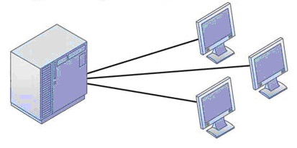
IT infrastructure
GENERAL-PURPOSE MAINFRAME AND
MINICOMPUTER ERA: 1959 TO PRESENT.
In 1965, the general-purpose
commercial mainframe com-
puter truly came into its own
with the introduction of the
IBM 360 series. The 360 was
the first commercial computer with a powerful operating system that could provide time sharing, multitasking, and virtual memory in more advanced models.

Slide 5
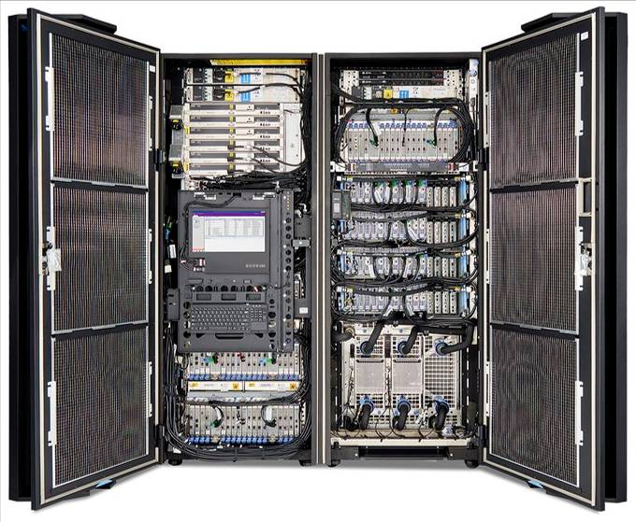
IT infrastructure
GENERAL-PURPOSE MAINFRAME AND
MINICOMPUTER ERA: 1959 TO PRESENT.
Mainframe computers eventually
became powerful enough to sup-
port thousands of online remote
terminals connected to a centrali-
zed mainframe using proprietary
communication protocols and pro-
prietary data lines. The first airline
reservation systems appeared in
1959 and became the prototypical online, real-time interactive computing system that could scale to the size of an entire nation.
*
* - https://i0.wp.com/www.enterprisetimes.co.uk/wp-content/uploads/2017/07/IBM_z14.jpg

Slide 6
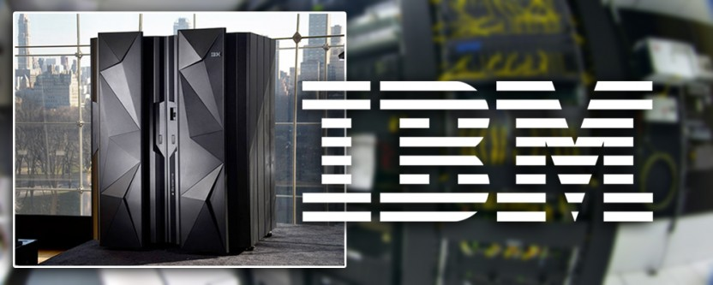
IT infrastructure
GENERAL-PURPOSE MAINFRAME AND
MINICOMPUTER ERA: 1959 TO PRESENT.
IBM dominated mainframe computing from 1965 onward and still dominates this more then $27 billion global market in 2019. Today IBM mainframe systems can work with a wide variety of different manufacturers’ computers and multiple operating systems on client/ server networks and networks based on Internet technology standards.
*
* - http://editimage.club/iresize.php?img=http://www.multivu.com/players/English/8013251-ibm-z-mainframe-data-protection/image/ibmnewera-1499979863054-12-HR.jpg

Slide 7
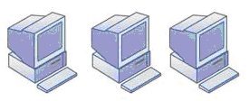
IT infrastructure
PERSONAL COMPUTER ERA: (1981 TO PRESENT).
Although the first truly perso-
nal computers (PCs) appeared
in the 1970s (the Xerox Alto,
MIT’s Altair, and the Apple I
and II, to name a few), these
machines had only limited distribution to computer enthusiasts. The appearance of the IBM PC in 1981 is usually credited as the beginning of the PC era because this machine was the first to become widely adopted in American businesses.

Slide 8
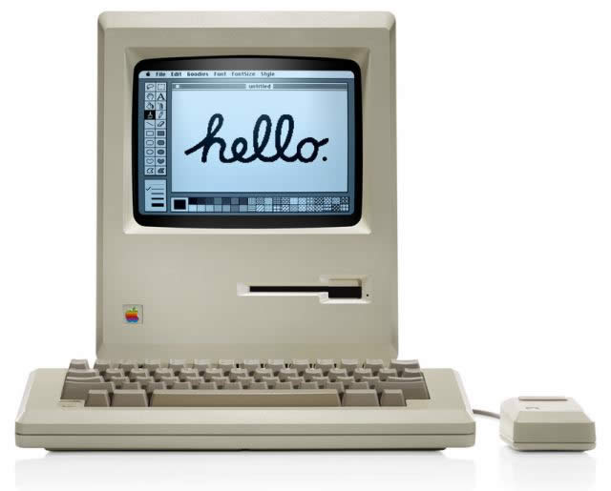
IT infrastructure
PERSONAL COMPUTER ERA: (1981 TO PRESENT).
At first using the DOS opera-
ting system, a text-based com-
mand language, and later the
Microsoft Windows operating
system, the Wintel PC compu-
ter (Windows operating sys-
tem software on a computer with an Intel microprocessor) became the standard desktop personal computer. Today, 95 percent of the world’s estimated 1 billion computers use the Wintel standard.
*
* - https://3dnews.ru/assets/external/illustrations/2014/02/02/800278/mac128k.jpg

Slide 9
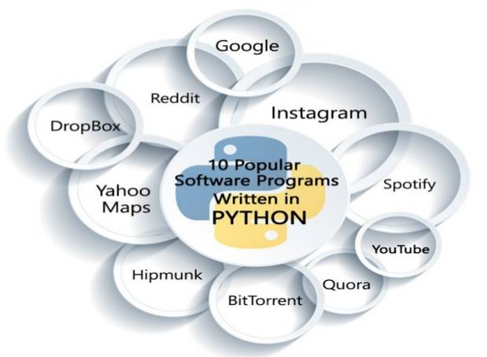
IT infrastructure
PERSONAL COMPUTER ERA: (1981 TO PRESENT).
Proliferation of PCs in the
1980s and early 1990s la-
unched a spate of personal
desk- top productivity soft-
ware tools – word proces-
sors, spreadsheets, electro-
nic presentation software, and small data management programs that were very valuable to both home and corporate users. These PCs were standalone systems until PC operating system software in the 1990s made it possible to link them into networks.
*
* - https://www.slideshare.net/laraissacc/10-popular-software-programs-written-in-python

Slide 10
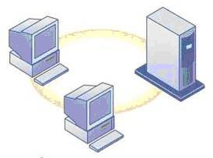
IT infrastructure
CLIENT/SERVER ERA: (1983 TO PRESENT).
In client/server computing,
desktop or laptop computers
called clients are networked to
server computers that provide
the client computers with a va-
riety of services and capabilities.
Computer processing work is
split between these two types
of machines. The client is the user point of entry, whereas the server provides communication among the clients, processes and stores shared data, serves up Web pages, or manages network activities.
*
* - https://www.linkedin.com/pulse/evolution-infrastructure-paul-m-veillard

Slide 11
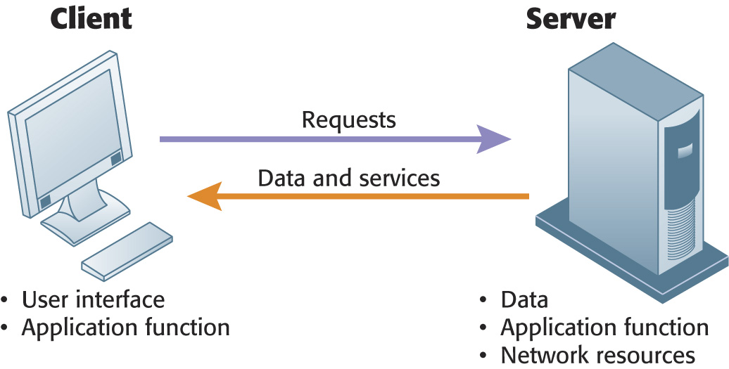
IT infrastructure
CLIENT/SERVER ERA: (1983 TO PRESENT).
*
In client/server computing, computer processing is split
between client machines and server machines linked by a
Network users interface with the client machines.
* - https://www.linkedin.com/pulse/evolution-infrastructure-paul-m-veillard
Notes:
You might point out to students the confusion that results from the word “server.” A server is a physical computer. It’s also the software that runs on that computer which “serves” user requests. The intended meaning often comes from the context in which it is used. If someone says we had to “purchase a number of servers,” it usually means the purchase of computers. When people say “the server is down” they usually mean the computer is down.
11

Slide 12
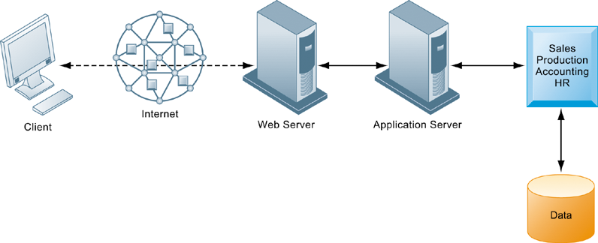
IT infrastructure
CLIENT/SERVER ERA: (1983 TO PRESENT).
*
In a multitiered client/server network (N-Tier), client requests for service are handled by different levels of servers.
* - https://www.linkedin.com/pulse/evolution-infrastructure-paul-m-veillard
Notes:
Corporations and even small firms usually separate the application processing (usually a database application) from the Web page server function. Although not necessarily on different physical servers, often this separation does involve a separate physical server for applications.
12

Slide 13
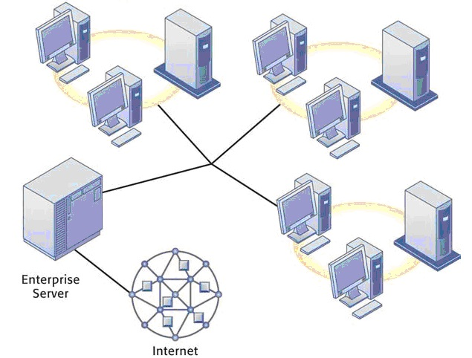
IT infrastructure
ENTERPRISE INTERNET COMPUTING ERA:
(1992 TO PRESENT).
*
* - https://www.linkedin.com/pulse/evolution-infrastructure-paul-m-veillard

Slide 14
IT infrastructure
ENTERPRISE INTERNET COMPUTING ERA:
(1992 TO PRESENT).
The success of the client/server model posed a new set of problems for corporations. Many large firms found it difficult to integrate all of their local area networks (LANs) into a single, coherent corporate computing environment. Applications developed by local departments and divisions in a firm, or in different geographic areas, could not communicate easily with one another and share data. In the early 1990s, firms turned to networking standards and software tools that could integrate into an enterprise-wide infrastructure.

Slide 15
IT infrastructure
ENTERPRISE INTERNET COMPUTING ERA:
(1992 TO PRESENT).
The resulting IT infrastructure links different types and brands of computer hardware and smaller networks into an enterprise-wide network so that information can flow freely across the organization and between the firm and other organizations. Enterprise net- works link mainframes, servers, PCs, mobile phones, and other handheld devices, and connect to public infrastructures such as the telephone system, the Internet, and public network services.

Slide 16
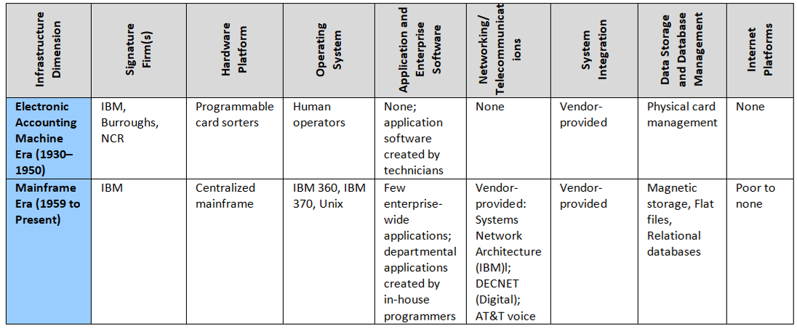
IT infrastructure
Stages in the IT Infrastructure Evolution

Slide 17
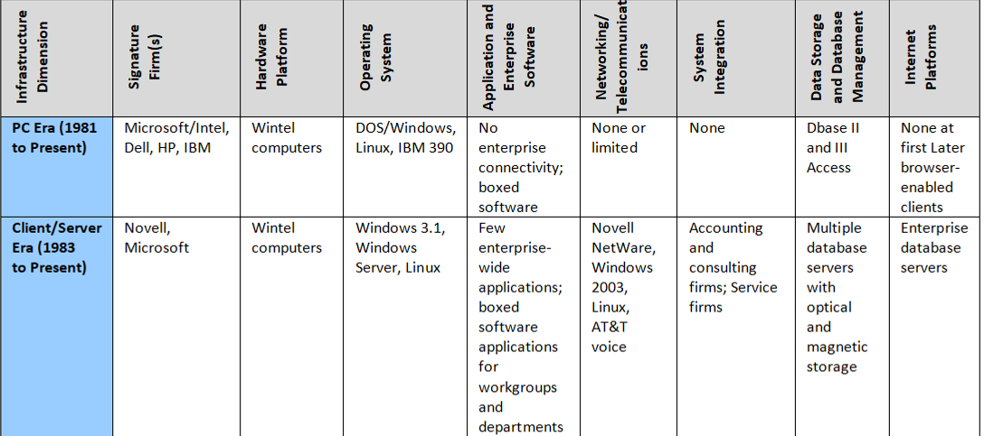
IT infrastructure
Stages in the IT Infrastructure Evolution

Slide 18
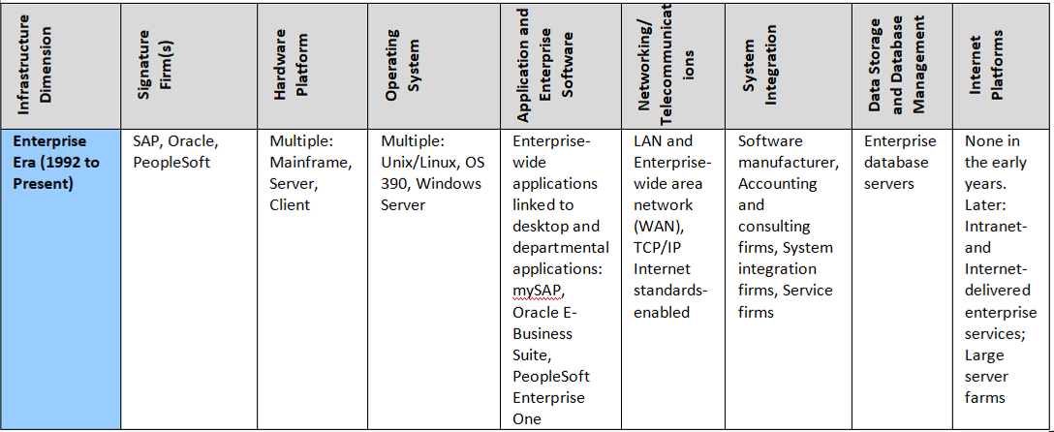
IT infrastructure
Stages in the IT Infrastructure Evolution

Slide 19
IT infrastructure
Stages of IT Infrastructure in
“IT infrastructure Library (ITIL)
VIDEO
Part 1
https://www.moodle.hneu.edu.ua/mod/resource/view.php?id=4650

Slide 20
IT infrastructure
Stages of IT Infrastructure in
“IT infrastructure Library (ITIL)
VIDEO
Part 2
https://www.moodle.hneu.edu.ua/mod/resource/view.php?id=4651

