Slide 1
IT infrastructure
Subtopic 1.1.3 Lifecycle of IT-infrastructure.

Slide 2
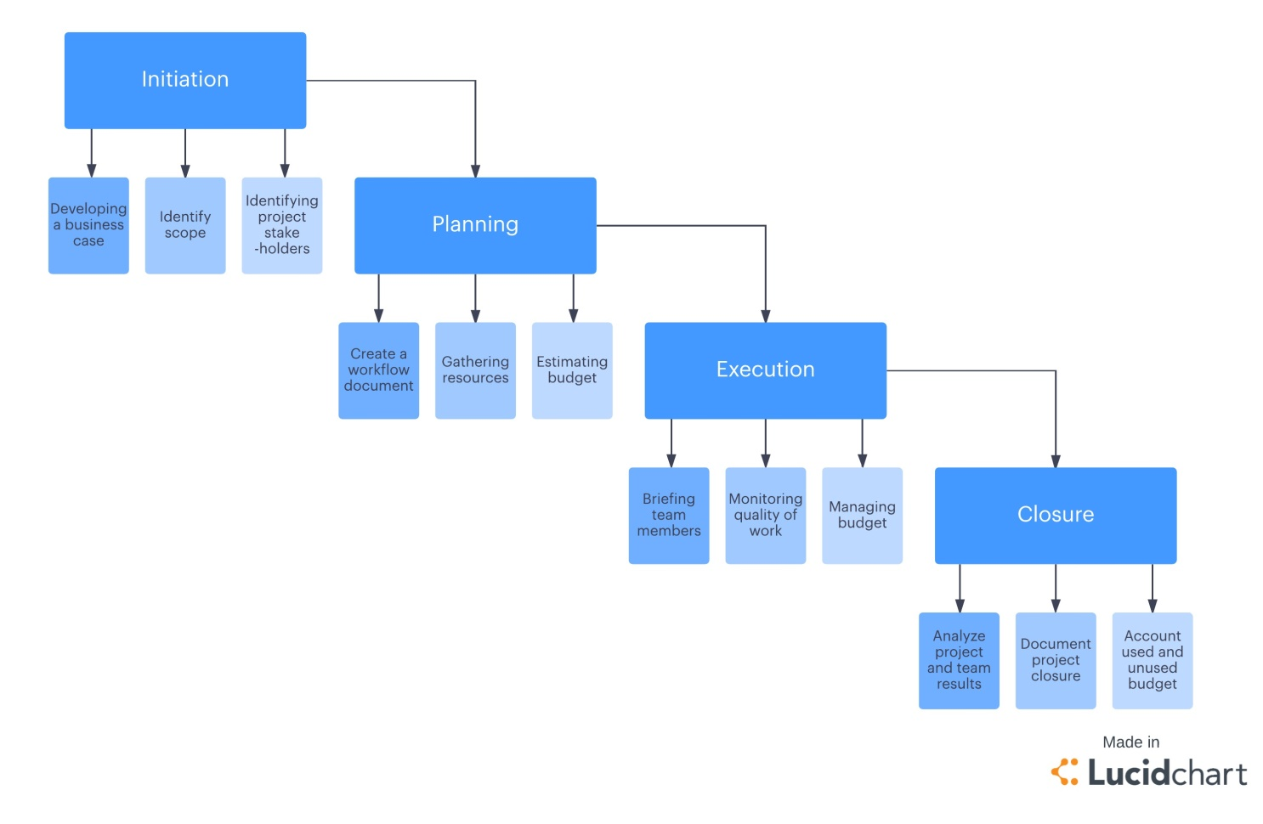
IT infrastructure
Life Cycle of IT Infrastructure
https://www.lucidchart.com/blog/the-4-phases-of-the-project-management-life-cycle

Slide 3
IT infrastructure
IEEE software life cycle Standards
SQA – Software quality assurance IEEE 730
SCM – Software configuration management IEEE 828
STD – Software test documentation IEEE 829
SRS – Software requirements specification IEEE 830
V&V – Software verification and validation IEEE 1012
SDD – Software design description IEEE 1016
SPM – Software project management IEEE 1058
SUD – Software user documentation IEEE 1063

Slide 4
IT infrastructure
ISO life cycle Standards
ISO/IEC/IEEE 15288:2015
Systems and software engineering -- System life cycle processes
ISO/IEC/IEEE 12207:2017
Systems and software engineering -- Software life cycle processes

Slide 5
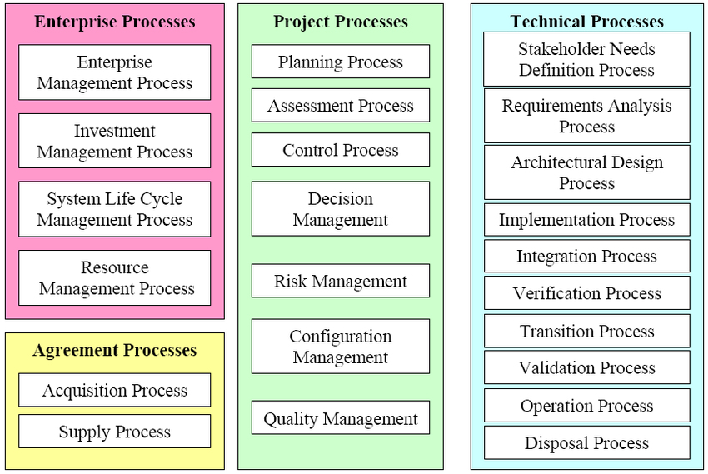
IT infrastructure
ISO/IEC/IEEE 15288:2015 - Systems and software engineering -- System life cycle processes
https://www.researchgate.net/figure/The-system-life-cycle-processes-Source-ISO-IEC-15288-Figure-D8_fig8_228815403

Slide 6
IT infrastructure
ISO/IEC/IEEE 12207:2017 - Systems and software engineering -- Software life cycle processes
https://viewletter.co/equipment-validation-life-cycle-bing-images/

Slide 7
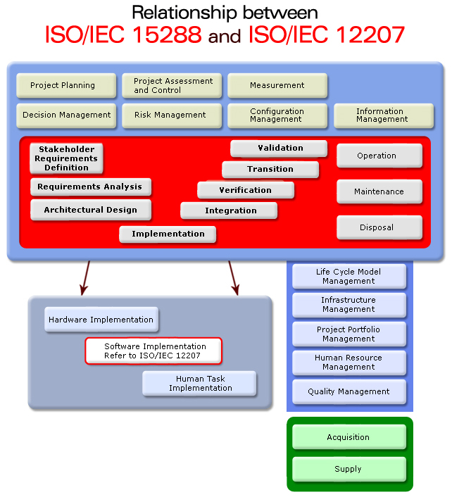
IT infrastructure
15288 Relationship to 12207
http://www.15288.com/relationship.php

Slide 8
IT infrastructure
Life Cycle Standards Video
VIDEO
INTRODUCTION IEEE 12207 PART 1
https://www.moodle.hneu.edu.ua/mod/resource/view.php?id=4630

Slide 9
IT infrastructure
Life Cycle Standards Video
VIDEO
Systems and Software Development Standards
https://www.moodle.hneu.edu.ua/mod/resource/view.php?id=4631

Slide 10
IT infrastructure
Life Cycle Standards Video
VIDEO
Systems and Software Development Standards
https://www.moodle.hneu.edu.ua/mod/resource/view.php?id=4632

