Slide 1
IT infrastructure
Subtopic 1.1.2. Types and Examples of IT-infrastructure.

Slide 2
IT infrastructure
Typical ITIS:
• Personal information infrastructure
• Information infrastructure of the enterprise
• Virtual Information Infrastructure
• Industry Information Infrastructure
• Global Information Infrastructure

Slide 3
IT infrastructure
The Global Information Infrastructure is being developed as a global informational network of mass maintenance of the planet's population based on the integration of global and regional information and telecommunication systems, as well as digital television and radio broadcasting systems, satellite systems and mobile communications
- The system of scientific and cultural communications
- System of economic communications (banks and exchanges, in particular SWIFT)
- Social networks
- Global data warehouse and knowledge of search engines
- World Wide Web

Slide 4
IT infrastructure
Information infrastructure of production enterprise
https://metrolush.com/hot-standby-future-proofs-legacy-computer-systems/

Slide 5
IT infrastructure
Information infrastructure of bank
https://www.platinum.com.au/Insights-Tools/The-Journal/Global-Banks-vs-the-Big-Four

Slide 6
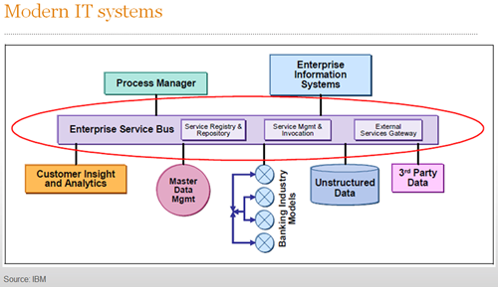
IT infrastructure
Information infrastructure of bank
https://www.platinum.com.au/Insights-Tools/The-Journal/Global-Banks-vs-the-Big-Four

Slide 7
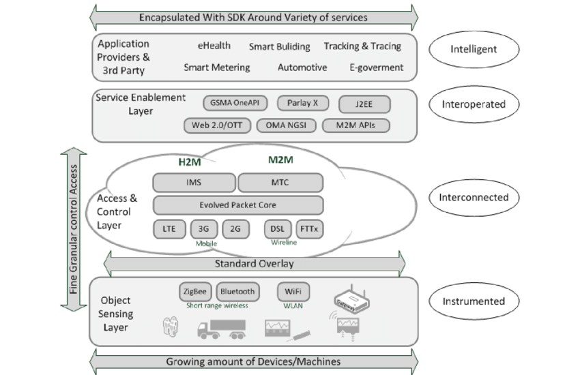
IT infrastructure
Information infrastructure of smart city
https://www.researchgate.net/figure/The-Smart-City-four-layer-architecture_fig2_257143664

Slide 8
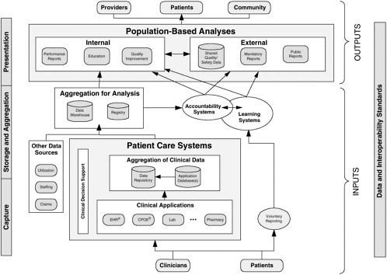
IT infrastructure
Clinical Information System Infrastructure
https://thebestphotos.eu/clinical-data-aggregation.html

