Slide 1
IT infrastructure
Subtopic 1.1.1. Definition of the notion «IT-infrastructure».

Slide 2
IT infrastructure
Type | Information Technology Infrastructure
Definition | The basic hardware, software, networks and facilities that serve as a foundation for an organization's information technology services.
Related Concepts | Networks Information Security Business Infrastructure Information Technology

Slide 3
IT infrastructure
Network Equipment - Network equipment such as routers.
Telecommunication Services - Services to connect to the internet and corporate facilities such as leased lines.
Computing - Computing hardware such as servers and basic software such as operating systems.
Facilities - Facilities that mostly house infrastructure such as data centers.
Power - Solar panels at a data center, solar battery systems, backup power generators and uninterruptible power supply.
Computing Platforms - Computing platforms such as an on-demand cloud computing platform.
Application Platforms - Application platforms such as a web server.
Content Platforms - Content management systems and similar software such as document management tools.
Communication Services - Communication tools such as voice over IP (VoIP) services and devices.
IT Services - Basic IT services such as data backup.
Information Security - Information security hardware and software such as a intrusion detection system.

Slide 4
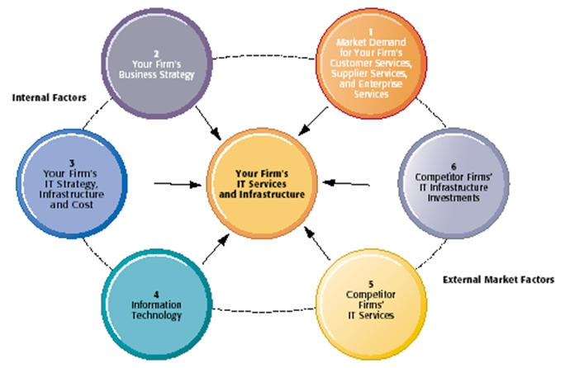
IT infrastructure
Competitive Forces Model for IT Infrastructure Investment
http://muna311.blogspot.com/2012/12/competitive-forces-model-calculating.html

Slide 5
IT infrastructure
The main forces was mentioned define the requirements for the functions and services of the IT infrastructure.
In the era of digital transformation, these services must support all the processes of a company's operation with a given quality, reliability and safety.

Slide 6
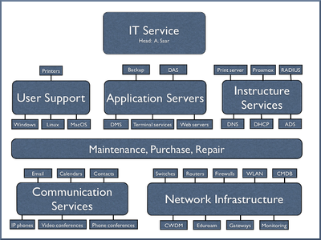
IT infrastructure
Infrastructure Functions and Services
http://www.aip.de/en/institute/facilities/it-service

Slide 7
Video
IT infrastructure
https://www.moodle.hneu.edu.ua/mod/resource/view.php?id=4633

