Slide 1
IT infrastructure
Subtopic 2.2.4. Unified communication

Slide 2
IT infrastructure
What Is Unified Communication?
Unified communication refers to the system architecture which integrates four main communication modes on the IP network, that is, voice, video, instant communication and data, providing a rich and simple communication environment for users.
Values of Unified Communication for Medium and Small Enterprises
The investment cost of unified communication is close to that of traditional SPC switch equipment. Unified communication data can directly make use of the existing private network or Internet transmission, thus greatly reducing the use cost of the telephone.
From the technical level, the unified communication adopts the IP technology and the IP protocol to realize the integration of service informatization, and effectively integrating all kinds of business of the enterprise and improving the efficiency of communication among the employees.
Demands of Unified Communication System
The unified communication system mainly includes office telephone, fax, meeting, instant message, file sharing, soft call, contact list, telephone roaming, and other services, and can be integrated with other systems of the enterprise.

Slide 3
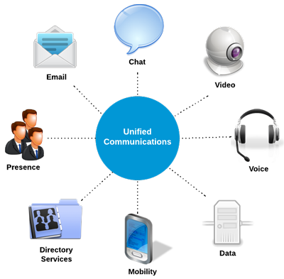
IT infrastructure
https://www.3cx.com/pbx/unified-communications/

Slide 4
IT infrastructure
Office Telephone /Fax Access
Apply the telephone and fax in the office area.
Internal intercommunication of office telephones
Sending and receiving of the office fax
Intercommunication between office phone and PSTN
Instant Messages
The daily business communication of the office area adopts the instant messaging, convenient and efficient.
Employee text chat
Multi-person text communication
Communication record saving
File Transmission Sharing
With the unified UC client, we can send documents in real time, making the office more intelligent and efficient.
File real-time transmission
Display the file transmission progress.
Cooperative Office
Realize the cooperative office by remote desktop sharing and document sharing.
Realize desktop sharing between two persons
Integrate the electronic whiteboard to communicate through text and graphics
Soft Call
After installing the unified communication client on the computer, connect the peripheral equipment on the computer such as headsets and cameras to realizing the point-to-point voice and video call:
Intercommunication with the ordinary telephone and the mobile phone;
Call transfer;
Call waiting;
Voice messages, and other telephone value-added services

Slide 5
IT infrastructure
Telephone Conference
In the daily office, the telephone conference is an indispensable way of communication. The unified communication platform can support the multi-party telephone conference function, meeting the conference demand of the enterprise customer.
Telephone conference reservation;
There are two modes: active participation and passive participation;
Auto inform the conference time and other information by email
Participants can use soft phones, ordinary phones, mobile phones and other terminals to take part in the conference.
Enterprise Communication Directory
When dialing the phone via the software address book, you do not need to find the address book, but only need to dial according to the employee name. This way does not care whether the number changes, and we only care about the name or other information in the address book.
The address book docks with the directory server of the school;
It can search according to the name of the staff;
It can complete functions, such as telephone and instant message, on the address book;
The communication directory information of the staff is updated automatically.

Slide 6
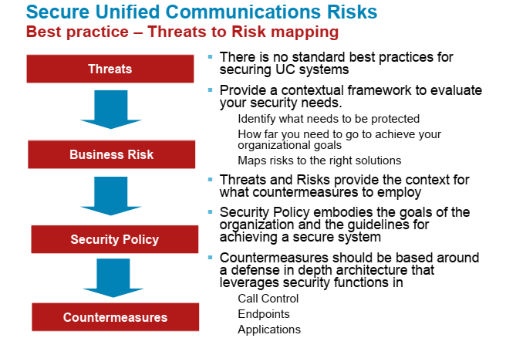
IT infrastructure

Slide 7
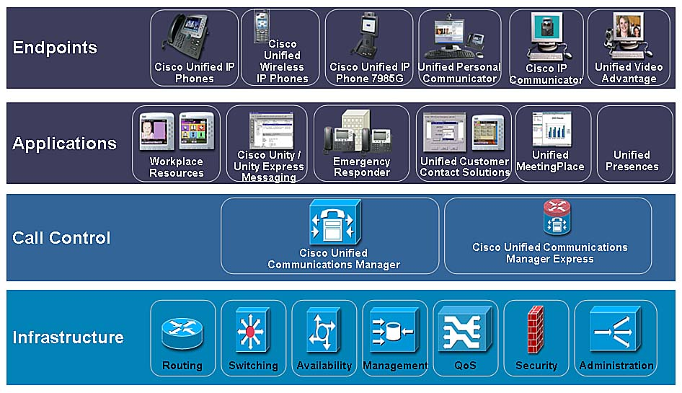
IT infrastructure
Cisco Unified Communications Solution Components
https://www.networkworld.com/article/2274082/lan-wan/chapter-1--cisco-unified-communications-manager-architecture.html

Slide 8
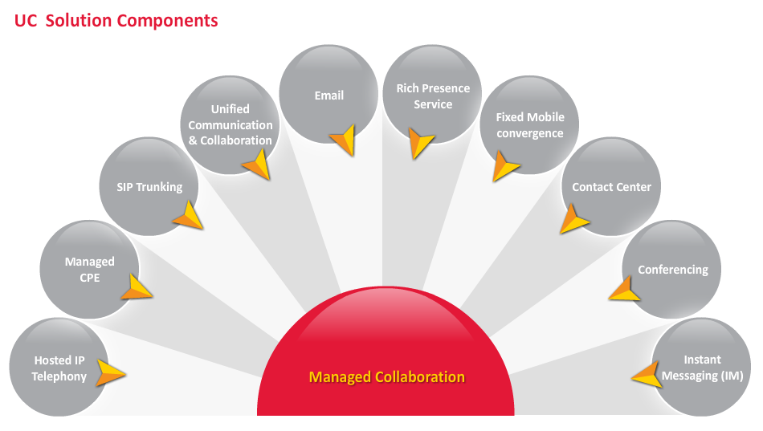
IT infrastructure
https://www.techmahindra.com/services/infrastructure-and-cloud-services/offerings/networks/network_platforms_and_applications/unified_communications.aspx

Slide 9
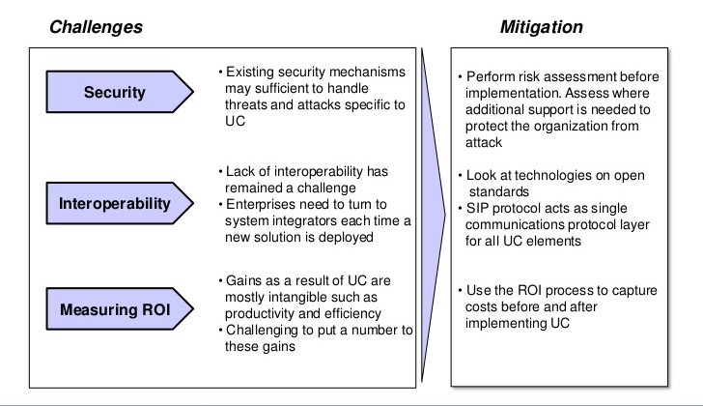
IT infrastructure

Slide 10
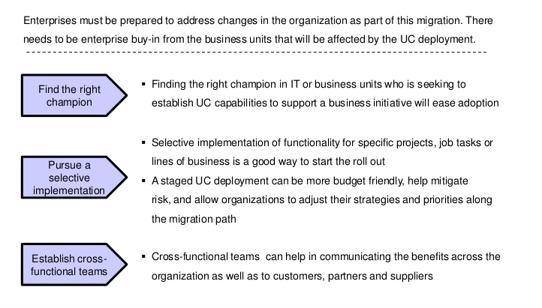
IT infrastructure

Slide 11
IT infrastructure
The 10 Biggest Unified Communications Risks
1. Minimal Data Center Security
2. Poor Response to Demand
3. Inadequate Data Encryption
4. Public Internet Connectivity
5. Poor Security and Access Controls
6. No On-Demand Account Management
7. Minimal Barriers to VoIP Toll Fraud
8. Vendor Experience
9. Poor Data Integrations
10. Nightmare Implementations

Slide 12
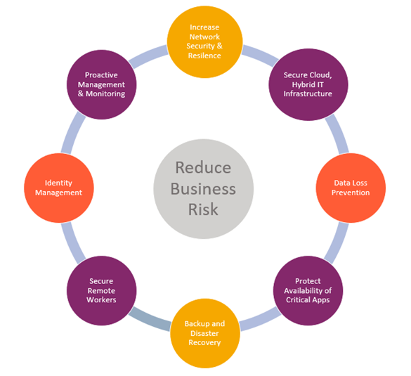
IT infrastructure

