Slide 1
IT infrastructure
Subtopic 2.2.3. The influence of Information security to Infrastructure risks

Slide 2
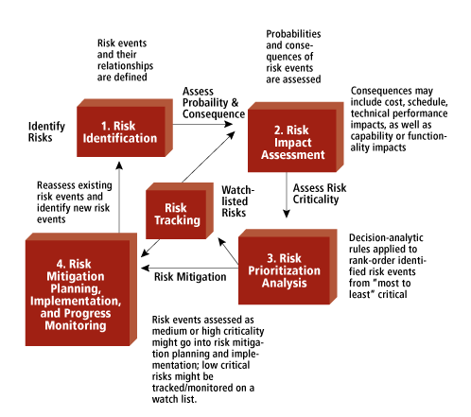
IT infrastructure
https://www.mitre.org/publications/systems-engineering-guide/acquisition-systems-engineering/risk-management/risk-mitigation-planning-implementation-and-progress-monitoring

Slide 3
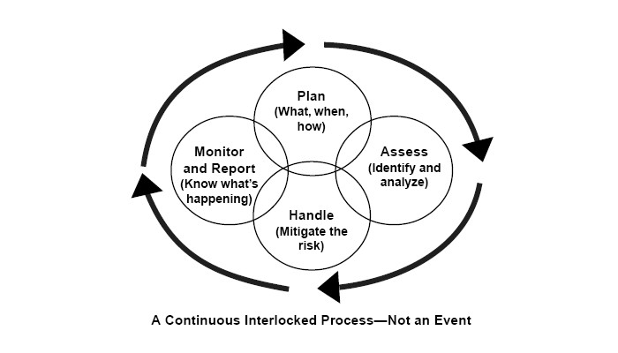
IT infrastructure
http://www.bmpcoe.org/library/books/sef/572.html

Slide 4
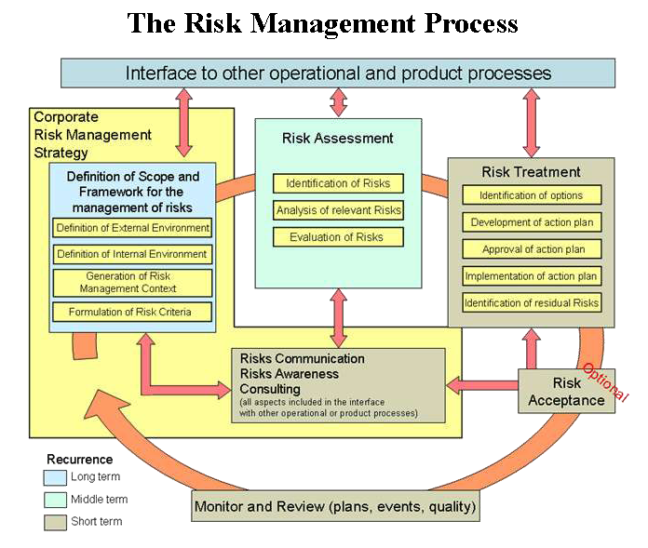
IT infrastructure
The Risk Management Process, according to ISO Standard 13335
https://en.m.wikipedia.org/wiki/IT_risk_management

Slide 5
IT infrastructure
LIKELIHOOD | CONSEQUENCES
 | Insignificant | Negligible | Moderate | Major | Extreme
Remote | VERY LOW | VERY LOW | LOW | MEDIUM | HIGH
Unlikely | VERY LOW | LOW | MEDIUM | MEDIUM | HIGH
Possible | VERY LOW | LOW | MEDIUM | HIGH | VERY HIGH
Likely | VERY LOW | LOW | MEDIUM | HIGH | VERY HIGH
Almost certain | LOW | LOW | MEDIUM | HIGH | VERY HIGH

Slide 6
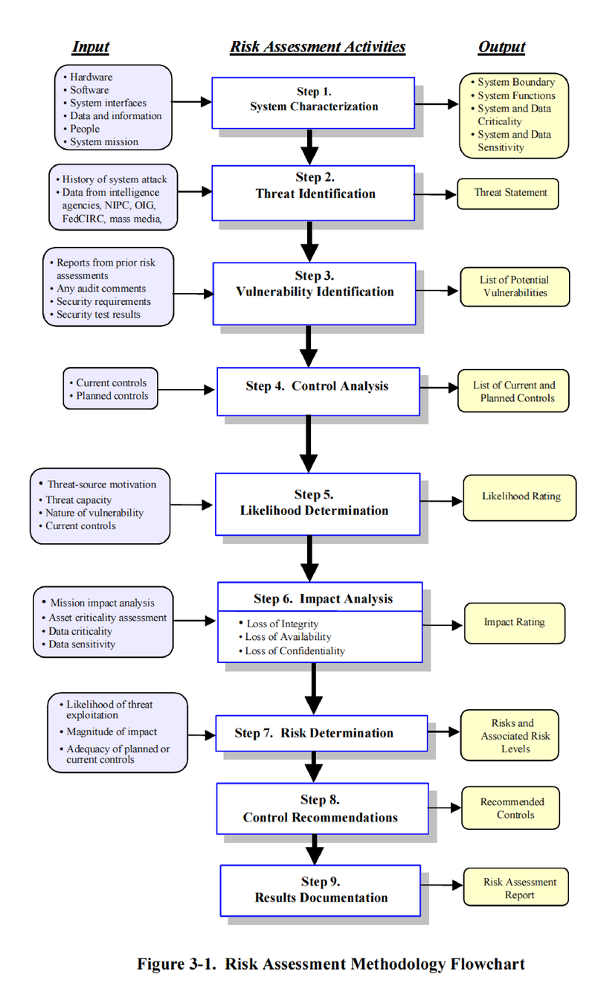
IT infrastructure
Risk assessment according NIST SP 800-30
https://en.m.wikipedia.org/wiki/IT_risk_management

Slide 7
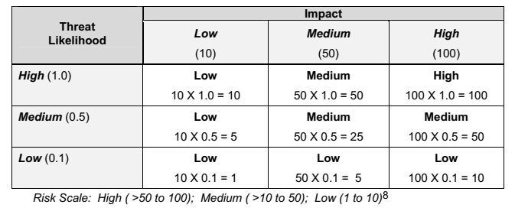
IT infrastructure
Risk –Level Matrix

Slide 8
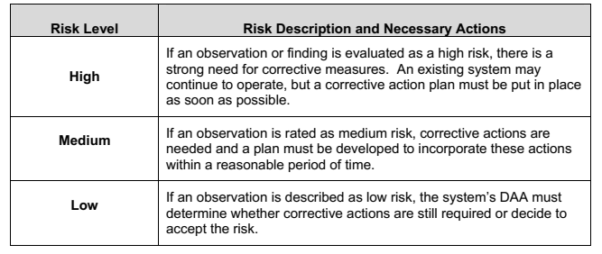
IT infrastructure
Risk Scale and Necessary Actions

Slide 9
IT infrastructure
Risk mitigation is a systematic methodology used by senior management to reduce mission risk. Risk mitigation can be achieved through any of the following risk mitigation options: • Risk Assumption. To accept the potential risk and continue operating the IT system or to implement controls to lower the risk to an acceptable level • Risk Avoidance. To avoid the risk by eliminating the risk cause and/or consequence (e.g., forgo certain functions of the system or shut down the system when risks are identified) • Risk Limitation. To limit the risk by implementing controls that minimize the adverse impact of a threat’s exercising a vulnerability (e.g., use of supporting, preventive, detective controls) • Risk Planning. To manage risk by developing a risk mitigation plan that prioritizes, implements, and maintains controls • Research and Acknowledgment. To lower the risk of loss by acknowledging the vulnerability or flaw and researching controls to correct the vulnerability • Risk Transference. To transfer the risk by using other options to compensate for the loss, such as purchasing insurance.

Slide 10
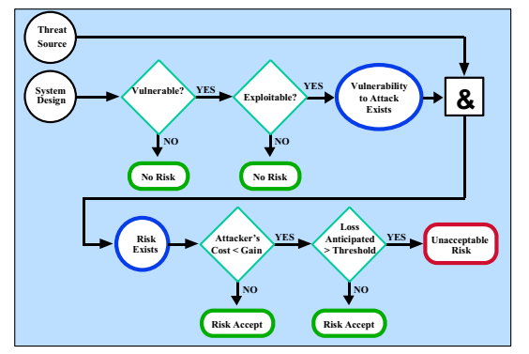
IT infrastructure
Risk mitigation action point according to NIST SP 800-30
https://en.m.wikipedia.org/wiki/IT_risk_management

Slide 11
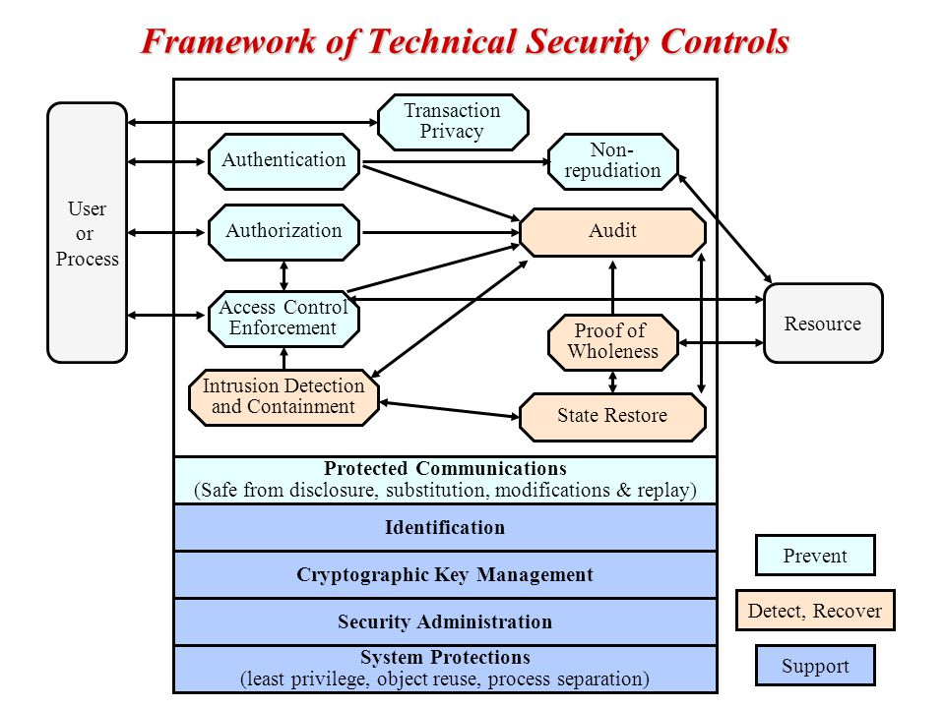
IT infrastructure
Technical Security Controls

Slide 12
IT infrastructure
Management Security Controls
Preventive:
Assign security responsibility.
Develop and maintain system security plan.
Implement personnel security controls such as separation of duties, least privilege, and user computer access registration and termination.
Conduct security awareness and technical training.
Detection:
Implement personnel security controls such as personnel clearance, background investigations, rotation of duties.
Conduct periodic review of security controls.
Perform periodic system audits.
Conduct ongoing risk management.
Authorize IT systems to address and accept residual risk.

Slide 13
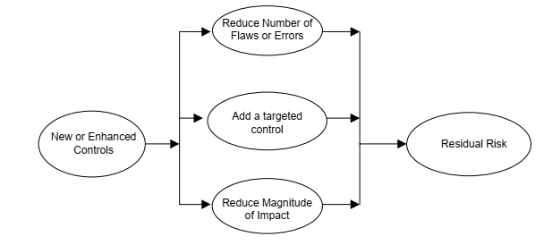
IT infrastructure
Implemented Controls and Residual Risk

