Slide 1
IT infrastructure
Subtopic 2.2.2. Systems of IS monitoring and control

Slide 2
IT infrastructure
What is Security Monitoring?
Security monitoring is the automated process of collecting and analysing indicators of potential security threats, then triaging these threats for appropriate action.
Security monitoring definition
Security monitoring, sometimes referred to as "security information monitoring (SIM)" or "security event monitoring (SEM)," involves collecting and analysing information to detect suspicious behavior or unauthorised system changes on your network, defining which types of behavior should trigger alerts, and taking action on alerts as needed.
Why security monitoring?
From hackers and malware, to disgruntled or careless employees, to outdated or otherwise vulnerable devices and operating systems, to mobile and public cloud computing, to third-party service providers, most companies are routinely exposed to security threats of varying severity in the normal course of conducting business. Given the ubiquitous, unavoidable nature of security risks, quick response time is essential to maintaining system security. And automated, continuous security monitoring is the key to quick threat detection and response.

Slide 3
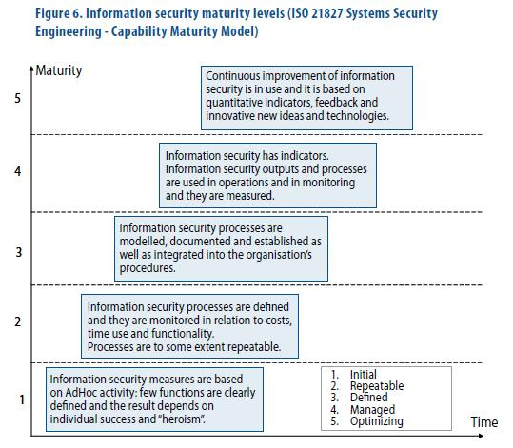
IT infrastructure
https://www.vahtiohje.fi/web/guest/organisation-of-information-security?p_p_id=56_INSTANCE_QwJ8&p_p_lifecycle=0&p_p_state=exclusive&p_p_mode=view&p_p_col_id=column-1&p_p_col_count=1&_56_INSTANCE_QwJ8_struts_action=%2Fjournal_content%2Fview&_56_INSTANCE_QwJ8_groupId=10128&_56_INSTANCE_QwJ8_articleId=32219&_56_INSTANCE_QwJ8_viewMode=print

Slide 4
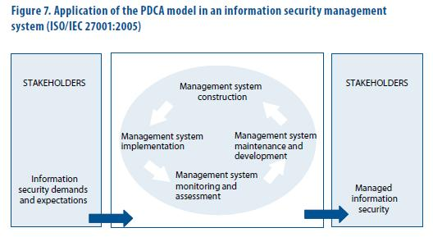
IT infrastructure
https://www.vahtiohje.fi/web/guest/organisation-of-information-security?p_p_id=56_INSTANCE_QwJ8&p_p_lifecycle=0&p_p_state=exclusive&p_p_mode=view&p_p_col_id=column-1&p_p_col_count=1&_56_INSTANCE_QwJ8_struts_action=%2Fjournal_content%2Fview&_56_INSTANCE_QwJ8_groupId=10128&_56_INSTANCE_QwJ8_articleId=32219&_56_INSTANCE_QwJ8_viewMode=print

Slide 5
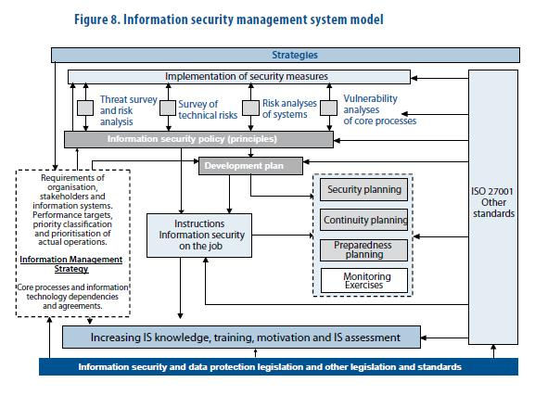
IT infrastructure

Slide 6
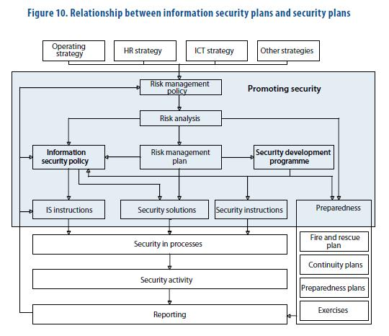
IT infrastructure

Slide 7
IT infrastructure
An example of information security reporting practices:
 | Reporting period | Subject
1 | Immediate reporting to management, operational management, key supervisors | A momentary event jeopardising opera­tions: serious threat, serious damage re­quiring immediate action to rectify, new risk or ‘close-shave’ event
2 | Weekly reporting to key individuals responsible for systems | Events of the week, automatically and ac­cording to requirements
3 | Monthly snapshot to security management | Monthly summary of events and measures by which an incident can be prevented in future or the risk reduced.
4 | Four-monthly review to senior management in accordance with the risk management policy | Security situation report (possibly as part of other reporting) as well as information on new threats, a survey of the information security of services.

Slide 8
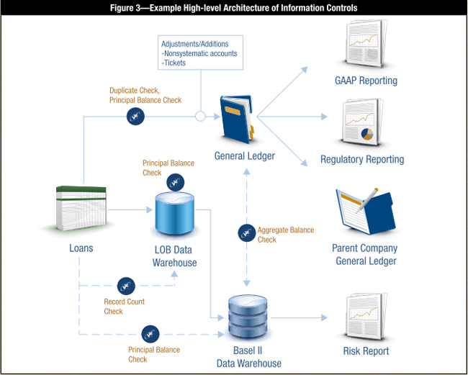
IT infrastructure
https://www.isaca.org/Journal/archives/2012/Volume-1/Pages/Information-Risk-Management-for-Supporting-a-Basel-II-Initiative.aspx?utm_referrer=

Slide 9
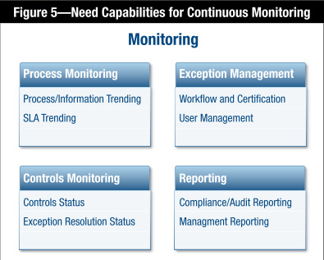
IT infrastructure
https://www.isaca.org/Journal/archives/2012/Volume-1/Pages/Information-Risk-Management-for-Supporting-a-Basel-II-Initiative.aspx?utm_referrer=

Slide 10
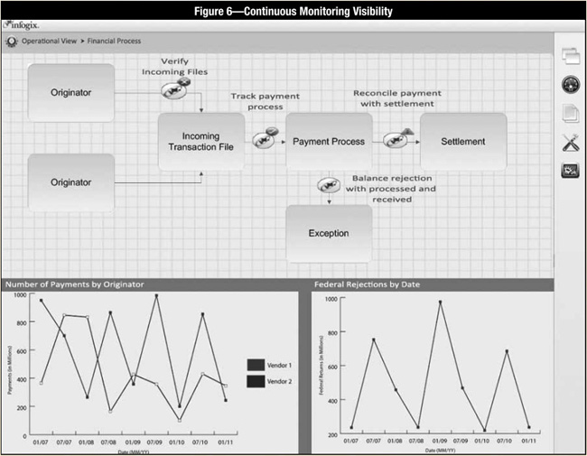
IT infrastructure
https://www.isaca.org/Journal/archives/2012/Volume-1/Pages/Information-Risk-Management-for-Supporting-a-Basel-II-Initiative.aspx?utm_referrer=

Slide 11
IT infrastructure
https://www.isaca.org/Journal/archives/2012/Volume-1/Pages/Information-Risk-Management-for-Supporting-a-Basel-II-Initiative.aspx?utm_referrer=

Slide 12
IT infrastructure
Top IT Infrastructure Monitoring Tools & Software of 2019
Solarwinds Network Performance Monitor (NPM)
Solarwinds Server and Application Monitor (SAM)
PRTG Network Monitor
WhatsUp Gold
Nagios XI
ManageEngine OpManager
OP5 Monitor
Notes:
As a network increases in size and importance, so does the need to ensure the network runs (and keeps running) effectively. To achieve this, it is necessary not only to know what devices make up the IT infrastructure (inventory) but also to keep an eye on those devices in terms of availability, health status and performance.
While it is possible to manually monitor IT infrastructure, especially on a small network, it can become quite time consuming and even out rightly impossible in most cases. Because of this, several tools are available to help with IT infrastructure monitoring and these tools will include features like:
A way to add devices/services to be monitored (e.g. text-based, CLI, GUI)
Availability, performance monitoring, and/or health status
Alerting to notify the appropriate persons when something goes wrong (or is about to go wrong) – SMS, Email, Etc.
Reporting to provide details about what has happened/is happening

