Slide 1
IT infrastructure
Subtopic 2.2.1. Notions and sources of information risks

Slide 2
IT infrastructure
Infrastructure risk is the potential for losses due to failures of basic services, organizational structures and facilities. By definition, infrastructure are core services upon which other services and business functions operate. As a result, the risks of infrastructure failures are often judged to have significant potential impact.

Slide 3
IT infrastructure
Overview: Infrastructure Risk
Definition | The potential for losses and business disruptions due to infrastructure failures.
Examples | A company's network goes down. A data center loses power. An airline's primary airport hub is closed due to a security incident.
Risk Treatments | Avoid Reduce Transfer Accept
Related Concepts | Security Risk

Slide 4
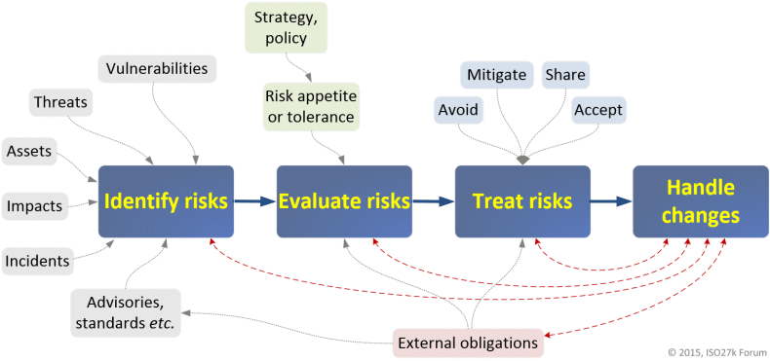
IT infrastructure
http://www.iso27001security.com/html/risk_mgmt.html

Slide 5
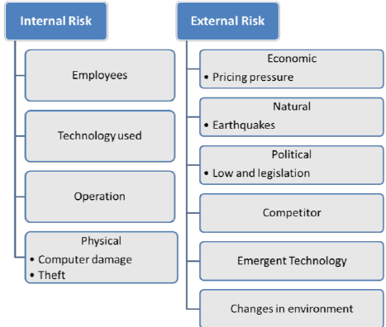
IT infrastructure

Slide 6
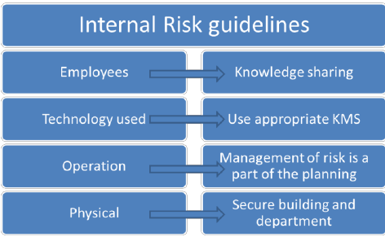
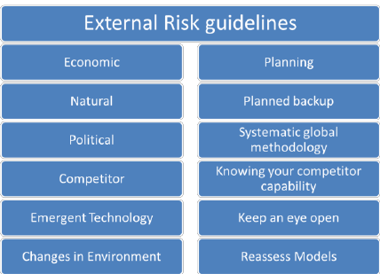
IT infrastructure

Slide 7
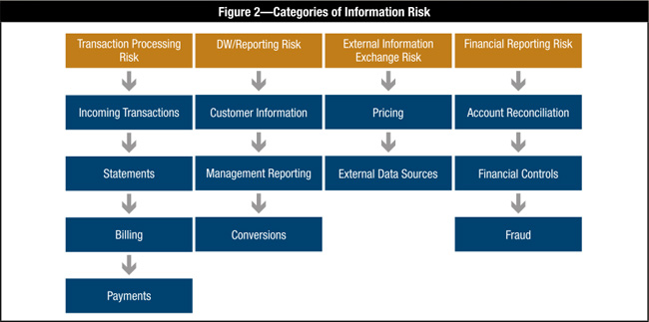
IT infrastructure
https://www.isaca.org/Journal/archives/2012/Volume-1/Pages/Information-Risk-Management-for-Supporting-a-Basel-II-Initiative.aspx?utm_referrer=

Slide 8
IT infrastructure
Types of Risks in Software Projects
Schedule Risk:
Project schedule get slip when project tasks and schedule release risks are not addressed properly.
Schedule risks mainly affect a project and finally on company economy and may lead to project failure. Schedules often slip due to the following reasons:
Wrong time estimation
Resources are not tracked properly. All resources like staff, systems, skills of individuals etc.
Failure to identify complex functionalities and time required to develop those functionalities.
Unexpected project scope expansions.
Budget Risk:
Wrong budget estimation.
Cost overruns
Project scope expansion

Slide 9
IT infrastructure
Types of Risks in Software Projects
Operational Risks:
Risks of loss due to improper process implementation failed system or some external events risks.
Causes of Operational risks:
Failure to address priority conflicts
Failure to resolve the responsibilities
Insufficient resources
No proper subject training
No resource planning
No communication in the team.
Technical risks: Technical risks generally lead to failure of functionality and performance. Causes of technical risks are:
Continuous changing requirements
No advanced technology available or the existing technology is in initial stages.
The product is complex to implement.
Difficult project modules integration.

Slide 10
IT infrastructure
Types of Risks in Software Projects
Programmatic Risks: These are the external risks beyond the operational limits. These are all uncertain risks are outside the control of the program. These external events can be:
Running out of the fund.
Market development
Changing customer product strategy and priority
Government rule changes.

Slide 11
IT infrastructure
Overview of key IT risks (based on COBIT5 for Risk)
Video - Part 1
https://www.moodle.hneu.edu.ua/mod/resource/view.php?id=4652

Slide 12
IT infrastructure
Overview of key IT risks (based on COBIT5 for Risk)
Video - Part 2
https://www.moodle.hneu.edu.ua/mod/resource/view.php?id=4653

Slide 13
IT infrastructure
Overview of key IT risks (based on COBIT5 for Risk)
Video - Part 3
https://www.moodle.hneu.edu.ua/mod/resource/view.php?id=4654

Slide 14
IT infrastructure
Overview of key IT risks (based on COBIT5 for Risk)
Video - Part 4
https://www.moodle.hneu.edu.ua/mod/resource/view.php?id=4655

