Slide 1
IT infrastructure
Subtopic 2.3.1 Essence and means of new information technologies monitoring

Slide 2
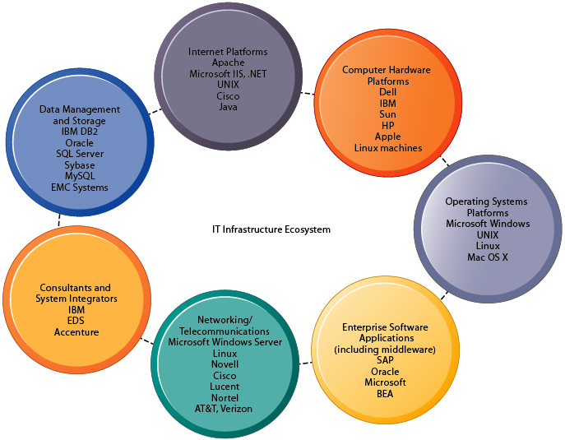
IT infrastructure
Subject of new information technologies monitoring
https://paginas.fe.up.pt/~als/mis10e/ch5/chpt5-2bullettext.htm
Notes:
IT infrastructure is composed of seven major components:
Computer hardware platforms include client machines and server machines, as well as modern mainframes produced by IBM. Blade servers are ultrathin servers, intended for a single dedicated application, and are mounted in space-saving racks.
Operating system platforms include platforms for client computers, dominated by Windows operating systems, and servers, dominated by the various forms of the UNIX operating system or Linux. Operating systems are software that manage the resources and activities of the computer and act as an interface for the user. Enterprise and other software applications include SAP, Oracle, and PeopleSoft, and middleware software that are used to link a firm's existing application systems.
Data management and storage is handled by database management software and storage devices include traditional storage methods, such as disk arrays and tape libraries, and newer network-based storage technologies such as storage area networks (SANs). SANs connect multiple storage devices on dedicated high-speed networks.
Networking and telecommunications platforms include Windows server operating systems, Novell, Linux, and UNIX. Nearly all LAN and many wide area networks (WANs) use the TCP/IP standards for networking.
Internet platforms overlap with, and must relate to, the firm's general networking infrastructure and hardware and software platforms. Internet-related infrastructure includes the hardware, software and services to maintain corporate Web sites, intranets, and extranets, including Web hosting services and Web software application development tools. A Web hosting service maintains a large Web server, or series of servers, and provides fee-paying subscribers with space to maintain their Web sites.
Consulting and system integration services are relied on for integrating a firm's legacy systems with new technology and infrastructure and providing expertise in implementing new infrastructure along with relevant changes in business processes, training, and software integration. Legacy systems are generally older transaction processing systems created for mainframe computers that continue to be used to avoid the high cost of replacing or redesigning them.

Slide 3
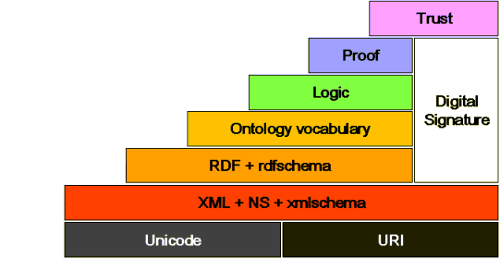
IT infrastructure
Semantic Web
Notes:
The Semantic Web is an extension of the World Wide Web through standards by the World WideWeb Consortium (W3C). The term was coined by Tim Berners-Lee for a web of data (or data web) that can be processed by machines—that is, one in which much of the meaning is machine-readable.

Slide 4
IT infrastructure
Automatic generation of ontology
DOI:10.1007/978-3-540-30475-3_50
Notes:
To generate ontology automatically, Formal Concept Analysis (FCA) is an effective technique that can formally abstract data as conceptual structures. To enable FCA to deal with uncertainty in data and interpret the concept hierarchy reasonably, ausors proposed to incorporate fuzzy logic into FCA for automatic generation of ontology.

Slide 5
IT infrastructure
Automatic generation of ontology
Use on-line services to build semantic network and find keywords to search information on new information technologies
On-line service for example is “BabelNet live”
Notes:
“BabelNet live” is the next evolutionary stage of “BabelNet”, today's most far-reaching multilingual resource that covers hundreds of languages and, according to need, can be used as either an encyclopedic dictionary, or a semantic network, or a huge knowledge base.”BabelNet” live is growing continuously, thanks to being fed with daily updates from all the sources that go to make it up, including Wikipedia, Wiktionary, users' input, etc.

Slide 6
IT infrastructure
Ways of new information technologies monitoring
Processing the perspective offers of producers and vendors
Mailing requests to potential developers
Continuous systematic search for new IT
Automated search for new IT based on ontologies and semantic networks

Slide 7
IT infrastructure
Resources of new information technologies monitoring
ITIL – Information Technology Infrastructure Library
IEEE Magazine “IT Professional”
ACM Magazine “Queue”
Google Scholar (search keywords “information infrastructure” and others from semantic network)
Notes:
IEEE “IT Professional” is a technical magazine of the IEEE Computer Society. It publishes peer-reviewed articles, columns and departments written for and by IT practitioners.
ACM “Queue” is a publication for software engineers that frames and defines the technical problems and challenges that loom ahead, helping readers to sharpen their own thinking and pursue innovative solutions. ACM Queue does not focus on either industry news or the latest "solutions." Rather, Queue articles explore technologies that are just on the verge of making a disruptive difference, highlighting problems that are likely to arise and posing questions that software engineers should be thinking about.

