Slide 1
IT infrastructure
Subtopic 2.1.2 Virtual solutions and cloud services

Slide 2
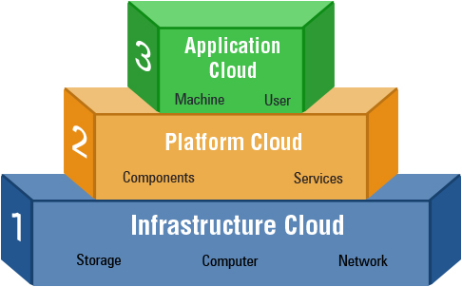
IT infrastructure
http://dentrodelasala.com/stunning-cloud-service-models/cloud-service-models-on-architecture-on-major-models-in-cloud-computing-ip-files/

Slide 3
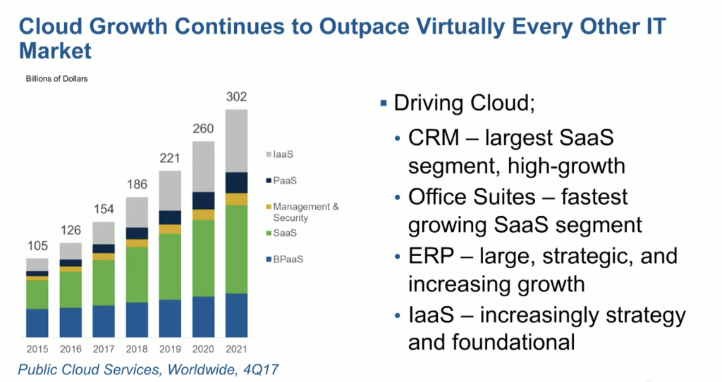
IT infrastructure
https://www.fourquadrant.com/go-to-market-cloud-computing-research/

Slide 4
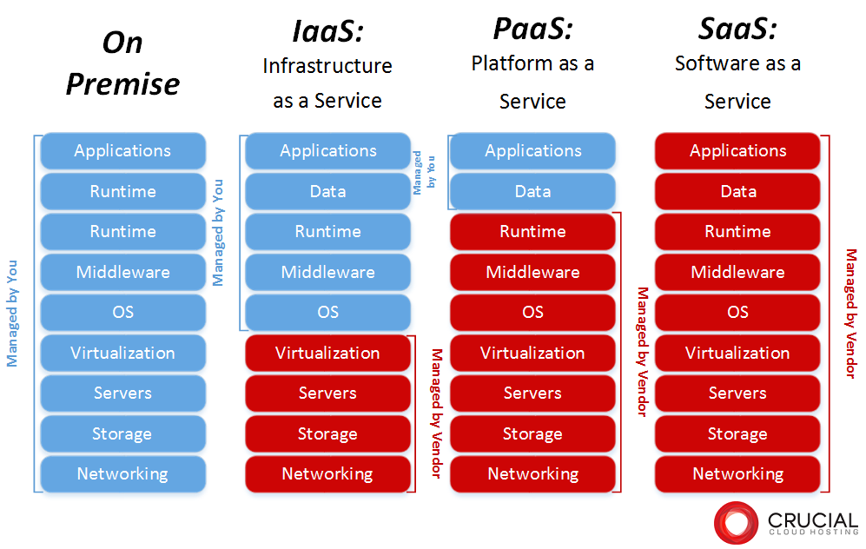
IT infrastructure
https://www.crucial.com.au/blog/2013/05/27/types-of-cloud-computing/

Slide 5
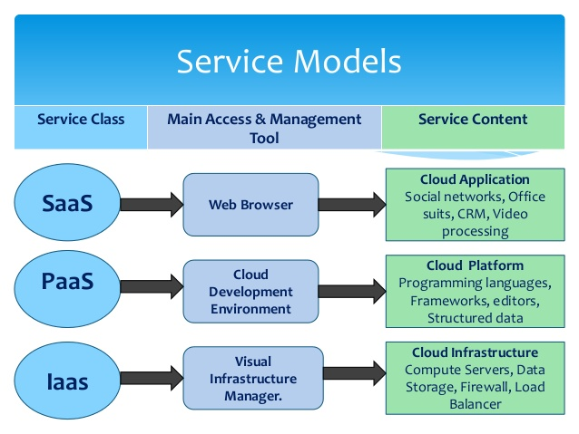
IT infrastructure
https://www.devteam.space/blog/top-10-cloud-computing-services-providers/

Slide 6
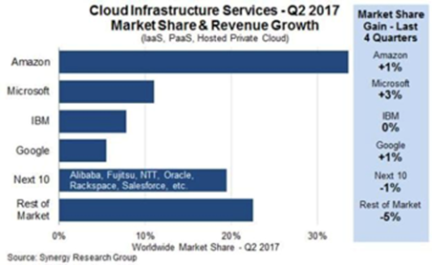
IT infrastructure
https://www.datacenterknowledge.com/business/microsofts-cloud-market-share-grew-more-anyone-elses-last-quarter-analysts

Slide 7
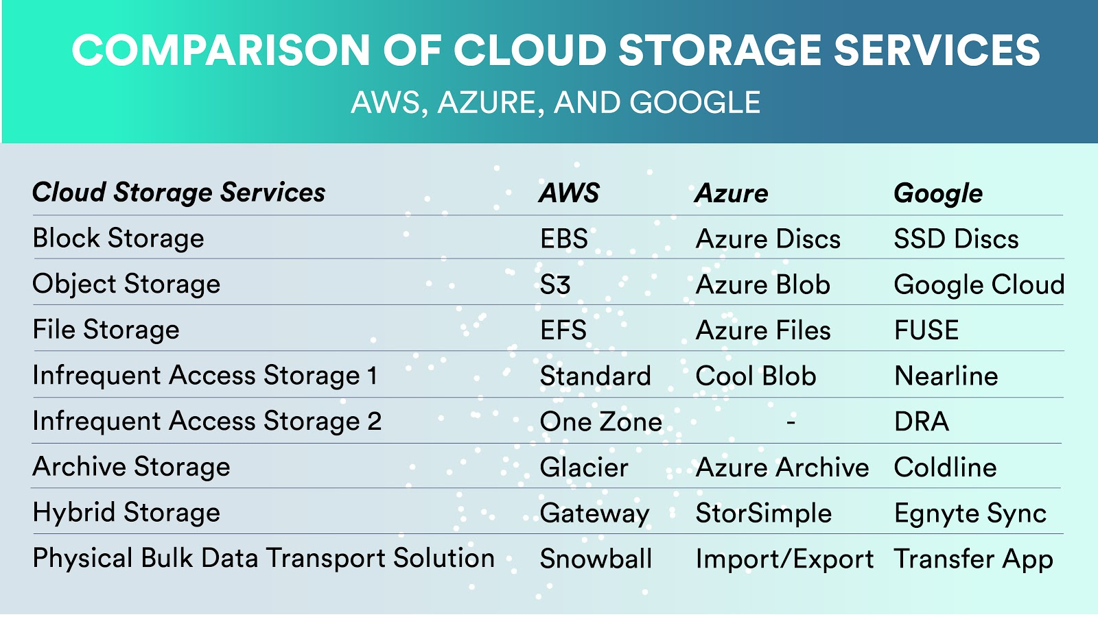
IT infrastructure
https://www.cloudhealthtech.com/blog/s3-cost-aws-cloud-storage-costs-explained

