Slide 1
IT infrastructure
Subtopic 1.2.3 Standards in the sphere of IS

Slide 2
IT infrastructure
Knowledge and compliance with the requirements of international standards in the field of IT infrastructure is the key to ensuring high quality and security of information services.
Without this, an enterprise cannot undergo an international audit and receive a quality certificate for working with serious foreign partners, place its shares on the stock exchange, etc.

Slide 3
IT infrastructure
Relationships of Key Standards Development Organization (SDO)
https://finance.yahoo.com/news/snia-supports-iso-iec-27040-140000876.html

Slide 4
IT infrastructure
There are many international standardization organizations. For IT infrastructure, the main ones are:
IEEE - Institute of Electrical and Electronics EngineersStandard Society,
ISO – International Standard Organization
SNIA - Storage Networking Industry Association
IEC - International Electrotechnical Commission
ISACA - Information Systems Audit and Control Association
Most of the used standards are adopted simultaneously in all or several organizations.

Slide 5
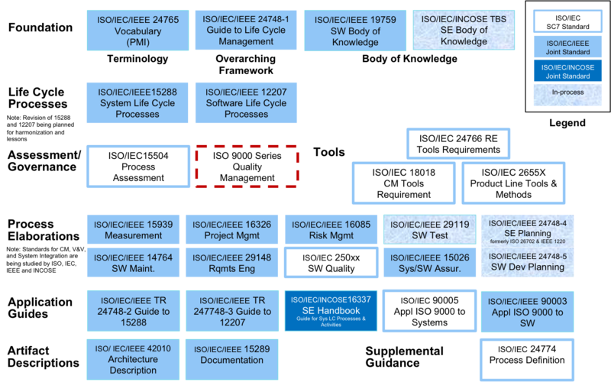
IT infrastructure
Alignment and Comparison of the ISO Standards in IT
https://www.sebokwiki.org/wiki/Alignment_and_Comparison_of_the_Standards

Slide 6
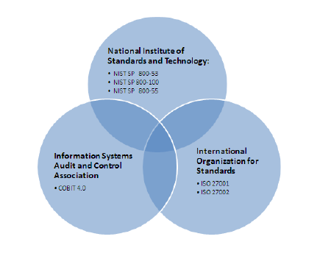
IT infrastructure
Relationship of Information Security Standards
https://www.researchgate.net/figure/Relationship-of-Information-Security-Standards_fig1_228991064

Slide 7
IT infrastructure
ISO/IEC-25000 – Quality Requirements and Evaluation
https://image.slidesharecdn.com/nevalainen-ohjelmistotuotanto-ja-jarjestelmakehitys-2017-10-18-171026072929/95/isoiec-25000-square-measurement-of-product-quality-software-system-service-data-7-638.jpg?cb=1509004381

Slide 8
IT infrastructure
VIDEO
ISO/IEC-15288 – Standard for IS processes
https://www.moodle.hneu.edu.ua/mod/resource/view.php?id=4649

