Slide 1
National Technical University of Ukraine “Igor Sikorsky Kyiv Polytechnic Institute“
Establishing Modern Master-level Studies in Information Systems
561592-EPP-1-2015-1- FR-EPPKA2-CBHE-JP
Tetiana Kovaliuk
tkovalyuk@ukr.net
Course ISDAD, November, 2017

Slide 2
Practical component of course “Methodology and Technologies of Information Systems Construction”.
Business Game
In information System Development and Deployment

Slide 3
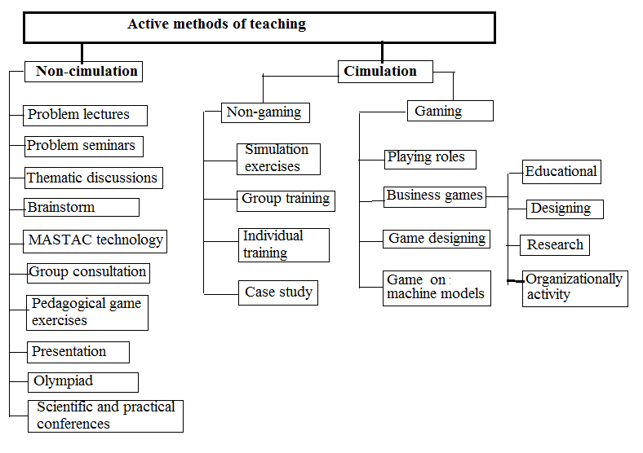
Classification active methods of teaching

Slide 4
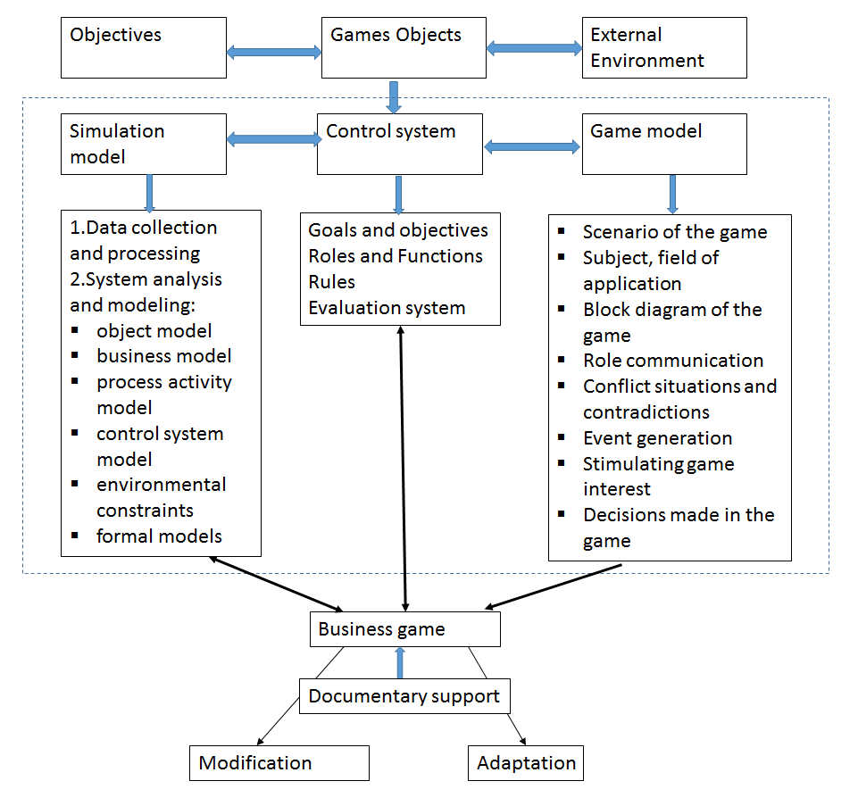
Block diagram of a business game

Slide 5
Themes of Business Games for course ISDAD
Subject Area - IS-Enterprise-Management
Strategy of innovative development of the organization
Creation and development of the company
Promotion of business
ERP system selection
Development CRM system for universities
Center for Development of IT Competencies
Exchange of IT projects for students
Job Exchange
Website development and promotion
Solving Management Problems

Slide 6
Themes of Business Games for course ISDAD
Subject Area - higher education
Management of competencies development of students of IT specialties
Analysis of requirements of stakeholders (employers) for bachelors and masters in IT specialties
Modeling the construction of a student road map
The process of interaction between IT industry and IT educations
Analysis of compliance of IT graduates competencies with the requirements of the European framework of competencies, stakeholders, Ukrainian and international educational standards
Modeling the work of the innovative design-oriented university
World trends and risks of education
Simulation of Sustainable Development Goals
Simulation of Sustainable Development Goals
Modeling of factors. which will determine the formation and development of new professions (2035)
Modeling projects for the development of educational "ecosystems" of the future (2030)

Slide 7
Game model
Game goals (purposes)
Game rolls
Game model
Game rules
Game scenario

Slide 8
Stages of the game and its description
Preparation
Determining the Actors and their roles
Distribution of tasks by players
Formation of goals
Formation of business ideas
Determining the rules of the game
Creation the scenatio of the game
Formation of the program of actor activities
Game evaluation
Summing up

Slide 9
Stages of the game and its description
Stage 1: Preparation - the task of the parameters of the game:
Game (title, course, start date, end date, task code)
Groups of game participants (game code, name, list of participants)
Roles in the stages of the game (game, stage, user-student code, role)
A role directory (manager, business analyst, financial analyst, expert)
Duration of the game stage (game code, stage code, duration (min))
Stage 2: Distribution of tasks by players
Example :
Manager - formation of the final reports on the diagnostics of the enterprise
Financial Analyst- diagnostic company based on financial analysis
Business Analyst - enterprise diagnostics based on situational analysis
Teacher - start / stop games, checking out the results
Result - diagnostics report is being prepared

Slide 10
Stages of the game and its description
Stage 3: Formation of game goals for game object
Manager:
formation of the list and characteristics of the goals,
the evaluation of the proposed goals,
the choice of goals among the ranked,
goal correction,
goal statement
Expert:
creating a list and characteristics of the goals,
evaluating the proposed goals
Instructor:
start / stop games,
test results
Result:
The list of proposed goals,
reports on the course of the game,
comparison of the main goal and the proposed goals

Slide 11
Stages of the game and its description
Stage 4 "Formation of Business Ideas“
Initial data for this stage is the stage "Formation of enterprise goals".
Leader:
Adoption of business ideas
Business analyst:
forming the composition,
justification and characteristics of business ideas
Expert:
adjusting the composition and characteristics of business ideas,
comments on business ideas
Teacher
start / stop games,
check results
.
Result:
The list of proposed business ideas,
reports on the progress of the game

Slide 12
Stages of the game and its description
Stage 5 "Formation of Enterprise Development Program"
The starting point for this stage is the stage "Diagnostics" and "Formation of enterprise goals".
Manager:
distribution of work volumes between the participants,
participation in the formation of enterprise development programs
Expert:
formation of any chap of enterprise development programs
Teacher:
start / stop games, check results
Result:
The list of development programs of the enterprise
report on the results of the game are formed

Slide 13
SAP ERP Business Game - Production
SAP ERP Business Game is a business game in which the work of a real SAP ERP system and its main modules is modeled on the example of a manufacturing enterprise.
In teams of 3-5 people, participants perform the business cycle of a small manufacturing company.
Teams interact with suppliers, buyers and internal production planning groups.
All team members participate in prompt decision making on the basis of reports from SAP ERP.
The goal of the game is to ensure the efficiency, productivity and profitability of the enterprise.

Slide 14
SAP ERP Business Game - Production
Objectives:
Understand the nature and benefits of integrating SAP business processes, and the need to work together all business functions
To strengthen the understanding of the value of SAP as a reporting and management system
Develop a basic understanding of navigation in SAP
Understand the advantages of the SAP ERP system for later communication with SAP clients
Exercise teamwork skills in the SAP project
Development of decision-making skills

Slide 15
Thank you for your attention
Tetiana Kovaliuk
tkovalyuk@ukr.net

