Slide 1
High Tech. Present Simple. Making sentences Lesson 1

Slide 2
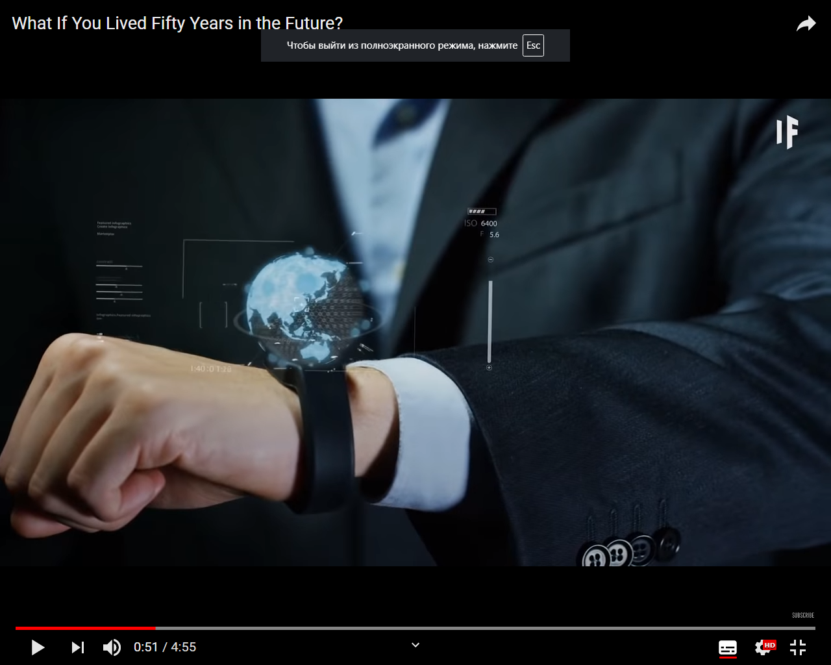

Slide 3
In linguistics, an internationalism or international word is a loanword that occurs in several languages (that is, translingually) with the same or at least similar meaning and tymology. These words exist in "several different languages as a result of simultaneous or successive borrowings from the ultimate source" (I.V.Arnold).
Pronunciation and orthography are similar so that the word is understandable between the different languages.

Slide 4
1)Vocabulary. Listen and repeat. Which words can you see in the picture?
1. digital TV
2. laptop
3. DVD player
4. mobile phone
5. MP3 player
6. robot helpers
7. digital camera
8. satellites
9. CCTV cameras
10. games console
2) Think! Are there any words which are international? Which ones? Make a conclusion.

Slide 5
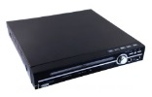
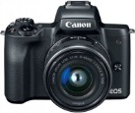
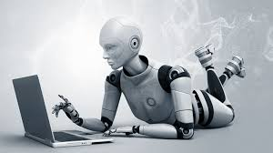
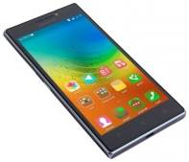
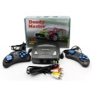
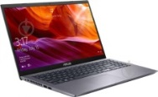
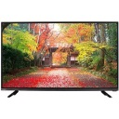
3) Match the words to their picture equivalents
1) digital TV | a)
2) laptop | b)
3) DVD player | c)
4) mobile phone | d)
5) MP3 player | e)
6) robot helpers | f)
7) digital camera | g)
8) satellites | h)
9) CCTV cameras | i)
10) games console | j)
Key
1-e
2-h
3-b
4-i
5-a
6-d
7-c
8-f
9-j
10-g

Slide 6
What do we use each item for? Use the phrases below to make sentences as in the example. Write them in your notebook.
We use a CCTV camera to make our streets safe.
Send emails
Make our streets safe
Store music files
Do the housework
listen to music
Surf the net
Watch films
Take pictures
Receive and transmit signals
Watch TV programmes
send text messages
Play video games
Call friends
Remember! Talking about habits and routines we use Present Simple.

Slide 7
We use the Present Simple tense to talk about:
• things that happen regularly;
• permanent situations;
• habits and routines;
• laws of nature;
• timetables and programmes.

Slide 8
TEST 1
Task 1. Match to form collocations
listen
send
take
read
watch
surf
the Net
pictures
electronic books
text messages
to music
films

Slide 9
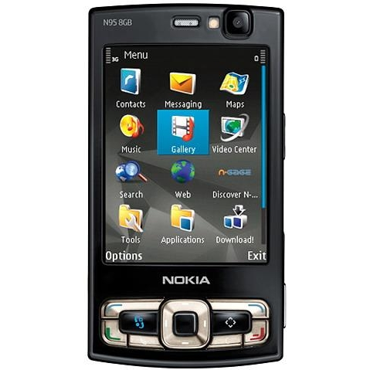
Task 2. Complete the advertisement with the missing verbs.
NOKIA #95
The future is here
Nokia # 95 is everything you want a computer to have in the size of a mobile phone!
You can:
• s……. and r……. text messages and emails
• t……. pictures
• w…… films
• p……. games
• s……. the Internet
• Also choose our Telecom 120 package and talk to friends and family for 2 hours every month free of charge!
Don’t waste any more time! Visit your nearest Telecom shop now!
end
eceive
ake
atch
lay
urf

Slide 10
Шкала оцінювання
Task 1 | 1бал за кожну правильну пару
1 | 1 бал
2 | 1 бал
3 | 1 бал
4 | 1 бал
5 | 1 бал
6 | 1 бал
Task 2 | 1бал за кожну правильну відповідь
7 | 1 бал
8 | 1 бал
9 | 1 бал
10 | 1 бал
11 | 1 бал
12 | 1 бал
Усього | 12 балів
Well done! You’ve completed the lesson.
If you failed, try again)

