Slide 1
Fester
Lurch
Morticia
Gomez
Eudora
Wedesday
Pugsley

Slide 2
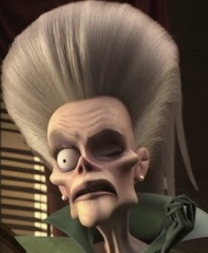
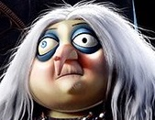
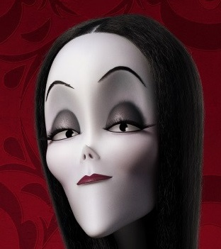
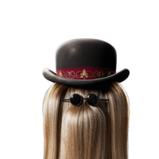
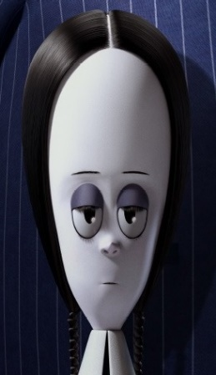
Sloom
Eudora
Morticia
Fester
Gomez
+
Itt
Wednesday
Pugsley

Slide 3
Gomez
parents
Wednesday
Pugsley
Morticia

Slide 4
husband
Gomez
wife
Morticia

Slide 5
sister
brother
Pugsley
Wednesday

Slide 6
Gomez
father
Wednesday
Pugsley

Slide 7
mother
Wednesday
Pugsley
Morticia

Slide 8
Gomez
daughter
son
Wednesday
Morticia
Pugsley

Slide 9
Eudora
grandmother
Wednesday
Pugsley

Slide 10
Sloom
grandmother
Wednesday
Pugsley

Slide 11
Sloom
Eudora
sister

Slide 12
Gomez
son
mother
Eudora

Slide 13
mother-in-law
daughter-in-law
Eudora

Slide 14
granddaughter
grandson
Wednesday
Eudora
Pugsley

Slide 15
Gomez
nephew
aunt
Sloom

Slide 16
Gomez
brother
Fester

Slide 17
niece
nephew
uncle
Wednesday
Fester
Pugsley

Slide 18
cousin
Fester
Itt
Gomez

