Slide 1
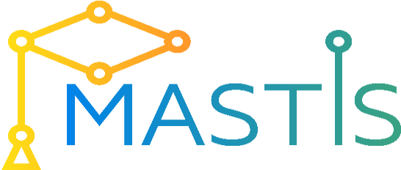
Topic 8
DevOps concepts
in the IS
Development
Process

Slide 2
Theoretical component content
DevOps overview
How DevOps differ from Agile
Principles of DevOps
Challenges for Development and Operations Team

Slide 3
Practical component
Using DevOps tools monitoring executions of :
Repeated jobs
Monitoring systems for cluster and grid monitoring capabilities
Real-time traffic analysis

Slide 4
What is DevOps?
DevOps = Dev (Development) + Ops (Operations)
Different people define DevOps in a variety of ways.
This definition from Wikipedia is a good starting point:
DevOps is a software engineering culture and practice that aims at unifying software development (Dev) and software operation (Ops)...
“DevOps aims at shorter development cycles, increased deployment frequency, more dependable releases, in close alignment with business objectives.”
Wikipedia 02. 2018

Slide 5
DevOps Model Defined (Amazon version)
DevOps is the combination of cultural philosophies, practices, and tools that increases an organization’s ability to deliver applications and services at high velocity: evolving and improving products at a faster pace than organizations using traditional software development and infrastructure management processes.
This speed enables organizations to better serve their customers and compete more effectively in the market.
https://aws.amazon.com/devops/what-is-devops/

Slide 6
DevOps Is NOT...
DevOps is NOT tools, but Tools are essential to success in DevOps
DevOps is NOT a standard
DevOps is NOT a product
DevOps is NOT a job title

Slide 7
How DevOps Works
Under a DevOps model, development and operations teams are no longer “siloed.”
Sometimes, these two teams are merged into a single team where the engineers work across the entire application lifecycle, from development and test to deployment to operations, and develop a range of skills not limited to a single function.
In some DevOps models, quality assurance and security teams may also become more tightly integrated with development and operations and throughout the application lifecycle. When security is the focus of everyone on a DevOps team, this is sometimes referred to as DevSecOps.

Slide 8
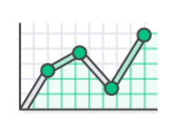
Benefits of DevOps Speed
Move at high velocity so you can innovate for customers faster, adapt to changing markets better, and grow more efficient at driving business results.
The DevOps model enables your developers and operations teams to achieve these results.
Notes:
For example, microservices and continuous delivery let teams take ownership of services and then release updates to them quicker.

Slide 9
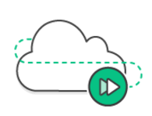
Benefits of DevOps Rapid Delivery
Increase the frequency and pace of releases so you can innovate and improve your product faster.
The quicker you can release new features and fix bugs, the faster you can respond to your customers’ needs and build competitive advantage.
Continuous integration and continuous delivery are practices that automate the software release process, from build to deploy.

Slide 10
Benefits of DevOps Reliability & Scale

Slide 11
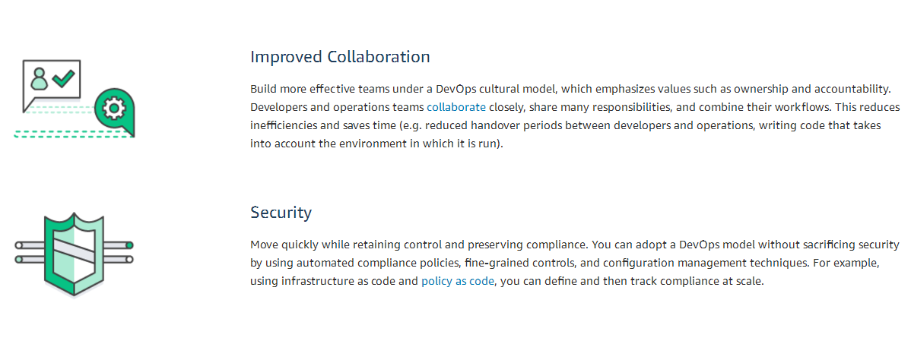
Benefits of DevOps Improved Collaboration & Security
Notes:
https://aws.amazon.com/devops/what-is-devops/

Slide 12
A Brief History of DevOps
Waterfall model
Agile model
Continuous model

Slide 13
When should you use waterfall methodology?
2. When clients won’t have the ability to change the scope of the project once it has begun.
-
3. When definition, not speed, is key to success.
1. When there is a clear picture of what the final product should be.
-
-
http://www.base36.com/2012/12/agile-waterfall-methodologies-a-side-by-side-comparison/

Slide 14
When should you use Agile methodology?
1. When rapid production is more important than the quality of the product.
2. When clients will be able to change the scope of the project.
3. When there isn’t a clear picture of what the final product should look like.
4. When you have skilled developers who are adaptable and able to think independently.
5. When the product is intended for an industry with rapidly changing standards.
http://www.base36.com/2012/12/agile-waterfall-methodologies-a-side-by-side-comparison/
Notes:
Both the Agile and waterfall methodologies have their strengths and weaknesses. The key to deciding which is right for you comes down to the context of the project. Is it going to be changing rapidly? If so, choose Agile. Do you know exactly what you need? Good. Then maybe waterfall is the better option. Or better yet? Consider taking aspects of both methodologies and combining them in order to make the best possible software development process for your project.

Slide 15
Disadvantages of Agile Methodology
1. With a less successful project manager, the project can become a series of code sprints. If this happens, the project is likely to come in late and over budget.
2. As the initial project doesn’t have a definitive plan, the final product can be grossly different than what was initially intended.
http://www.base36.com/2012/12/agile-waterfall-methodologies-a-side-by-side-comparison/

Slide 16
History of DevOps
2007
Agile software development popularity
2008
Agile conference in Toronto . Patrick Debois, a Belgian software developer, thought there has to be a better way to resolve the conflicts between developers and operations teams in order to get the work done quickly
2009
at the O’Reilly Velocity conference, two Flickr employees delivered a seminar on “10+ Deploys per day: Dev and Ops Cooperation at Flickr
2010
the first Devopsdays event was organized in the United States of America
https://www.cognixia.com/blog/history-of-devops

Slide 17
Traditional Problems
Dev and Ops are black boxes to each other
Because Ops is a black box, Devs don’t really trust them
Dev and Ops have different priorities, which pits them against each other:
Ops views Devs as breaking stability
And Ops doesn’t really trust Dev
Devs see ops as an obstacle to delivering their code
Dev is measured by delivering features, which means deploying changes
Even if they WANT to work together:
Ops is measured by uptime, but changes are bad for stability

Slide 18
Collaboration between Dev and Ops
Before DevOps, Dev and Ops have different and opposing goals
Actually, Dev and Ops work together and share the same goals
Dev care about stability as well as speed, and Ops care about speed as well as stability
The roles of Developers and Operational engineers can become blurred
Dev and Ops worked together to build a robust way of changing code quickly and reliably

Slide 19
Collaboration between Dev and Ops
Automation led to consistency:
Building, testing, and deploying happened the same way every time
Good monitoring, plus the swift deployment process, ensured problems could be fixed even before users noticed them:
Dev and Ops worked together up front to build good processes
Building, testing, and deploying happened much more quickly and more often
Even though a code change caused a problem, users experienced little or no downtime

Slide 20
DevOps Practices
Continuous Integration
Continuous Delivery
Microservices
Infrastructure as Code
Monitoring and Logging
Communication and Collaboration
https://aws.amazon.com/devops/what-is-devops/

Slide 21
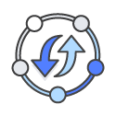
Continuous Integration
Continuous integration is a software development practice where developers regularly merge their code changes into a central repository, after which automated builds and tests are run.
The key goals of continuous integration are to find and address bugs quicker, improve software quality, and reduce the time it takes to validate and release new software updates.
https://aws.amazon.com/devops/what-is-devops/

Slide 22
Continuous Integration
Continuous Delivery and Continuous Deployment
Microservices
Infrastructure as Code
Monitoring and Logging
Communication and Collaboration
Configuration management
Orchestration
https://aws.amazon.com/devops/what-is-devops/

Slide 23
Configuration management
Maintaining and changing the state of pieces of infrastructure in a consistent, maintainable, and stable way
Changes always need to happen – configuration management is about doing them in a maintainable way

Slide 24
Orchestration
Orchestration: automation that supports processes and workflows, such as provisioning resources
With orchestration, managing a complex infrastructure is less like being a builder and more like conducting an orchestration

Slide 25
Monitoring
Monitoring: The collection and presentation of data about the performance and stability of services and infrastructure
Monitoring tools collect data over things such as:
Usage of memory
The collected data is presented in various forms, such as charts and graphs, or in the form of real-time notifications about problems
Cpu
disk i/o
Other resources over time
Application logs
Network traffic
etc.

Slide 26
Why do Monitoring?
Fast recovery
Better root cause analysis.
Visibility across teams
Automated response
Notes:
Fast recovery – The sooner a problem is detected, the sooner it can be fixed. You want to know bout a
problem before your customer does!
Better root cause analysis – The more data you have, the easier it is to determine the root cause of a
problem.
Visibility across teams –Good monitoring tools give useful data to both developers and operations
people about the performance of code in production.
Automated response –Monitoring data can be used alongside orchestration to provide automated
responses to events, such as automated recovery from failures

Slide 27
Microservices
A microservice architecture breaks an application up into a collection of small, loosely-coupled services
Traditionally, apps used a monolithic architecture. In a monolithic architecture, all features and services are part of one large application
Microservices are small: each microservice implements only a small piece of an application’s overall functionality

Slide 28
Microservices advantages
Modularity
Technological flexibility
Optimized scalability

Slide 29
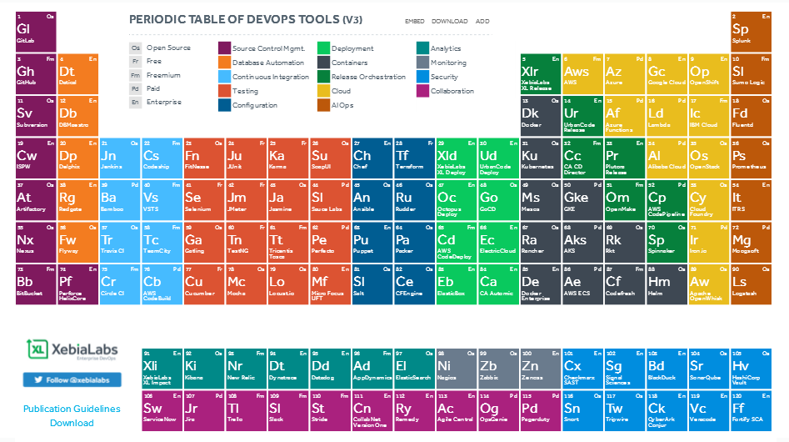
DevOps Tools
PERIODIC TABLE OF DEVOPS TOOLS
https://xebialabs.com/periodic-table-of-devops-tools/

Slide 30
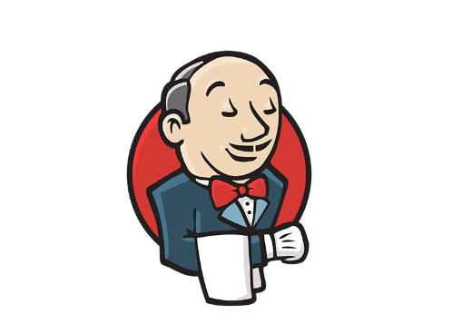
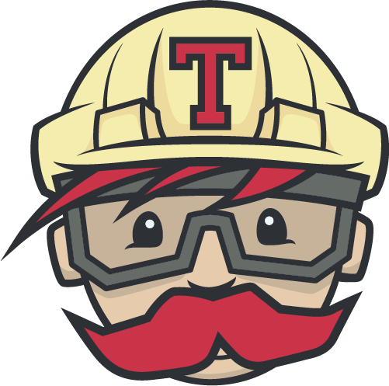
Tools for Build Automation and Continuous Integration
Continuous Integration – Continuously merging code into a single branch or mainline
Jenkins:
Open source – fork of Hudson
Widely used
TravisCI:
Open source
Built around Github integration
Java servlet-based
Executes builds in clean VMs

Slide 31
Tools for Configuration Management
Configuration Management –Managing and changing the state of pieces of infrastructure in a consistent and maintainable way
Kinds:
Open source
Declarative configuration
YAML configuration files
No control server needed – but Ansible tower is available
No agents needed, just python and ssh

Slide 32
Tools for Configuration Management
Configuration Management –Managing and changing the state of pieces of infrastructure in a consistent and maintainable way
Declarative configuration
Manage state through a UI
Custom modules use Puppet DSL
Pushes changes to clients using a control server and agents installed on clients

Slide 33
Tools for Configuration Management
Declarative configuration
Agent (minions) / server (master) – but can support agentless
Uses YAML
Support for event-driven automation

Slide 34
Tools for Virtualization and Containerization
Virtualization –Managing resources by creating virtual rather than physical machines
Containers – Lightweight, isolated packages containing everything needed to run a piece of software
Require fewer resources than VMs – VMs contain an entire OS plus virtual versions of all the hardware

Slide 35
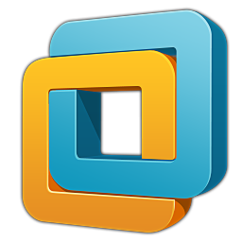
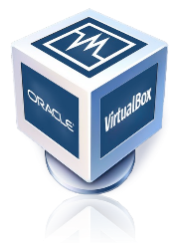
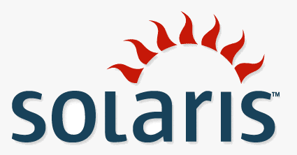
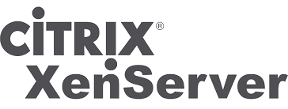
Tools for Virtualization
Examples:
VMWare ESX and ESXi
Microsoft Hyper-V
Oracle VM
Solaris LDOM
Citrix XenServer

Slide 36
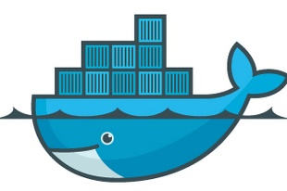
Tools for Containerization
Examples:
Docker – Docker is currently the leading container technology
OpenVZ

Slide 37
Monitoring Tools
Collecting and presenting data about the state and performance of applications
Infrastructure monitoring – focuses on things related to infrastructure
Application Performance Monitoring (APM) – focuses on performance and stability of individual parts of an application

Slide 38
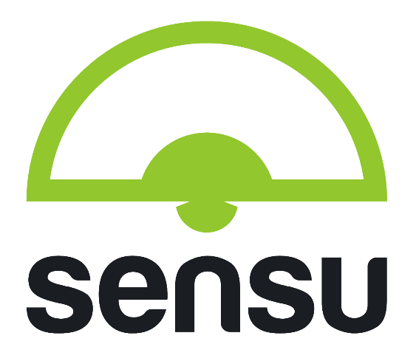
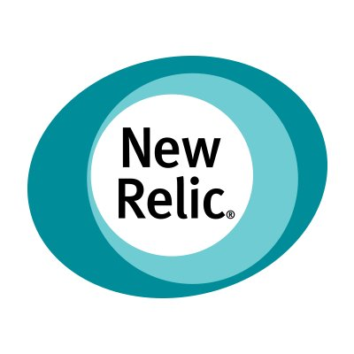
Monitoring Tools
Designed as a modern replacement for Nagios
Server/agent
SaaS + agent
Wide variety of metrics (also does APM)
Agents push data to an AMQP broker

Slide 39
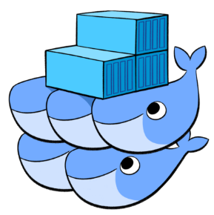
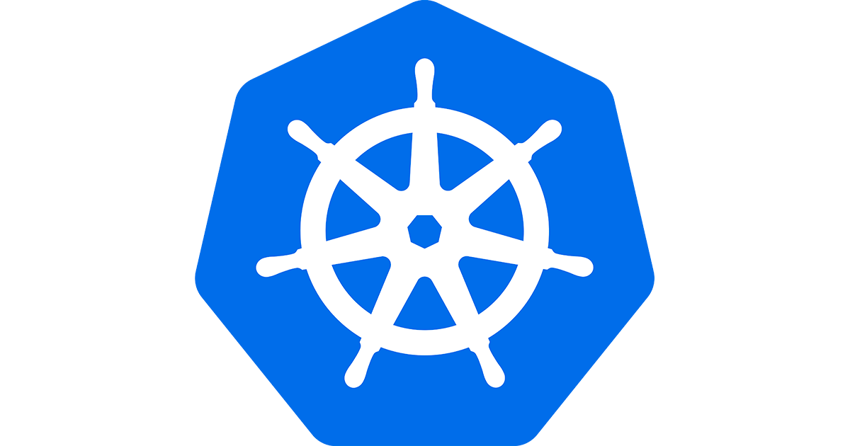
Tools for Orchestration
Orchestration – automation that supports processes and workflows, such as provisioning resources
Docker Swarm:
Docker-native
Orchestration for Docker containers
Kubernetes:
Open source
Orchestration server
Manage containerized apps across multiple hosts

Slide 40
Tools for Orchestration
Zookeeper:
Open source – Apache foundation
Can work alongside Kubernetes
Offers a centralized service registry that integrates with orchestration features

Slide 41
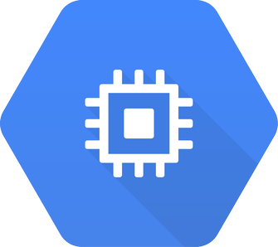
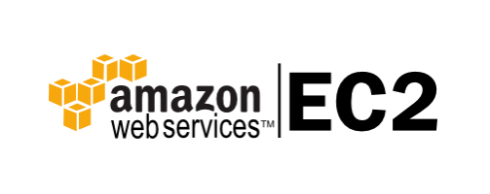
Traditional stack, IaaS, Paas
Cloud is a not traditional stack is a regular, self-hosted datacenter
With Infrastructure as a Service (IaaS), someone else provides the low-level infrastructure:
Amazon ec2 instances
Microsoft Azure VMs and containers
Google Compute Engine
Examples:

Slide 42
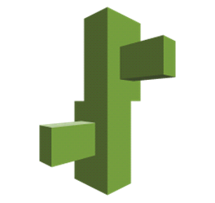
Traditional stack, IaaS, Paas
With Platform as a Service (PaaS), everything below the Application and Data layers is abstracted
Examples:
AWS Elastic Beanstalk
Heroku
Google App Engine

Slide 43
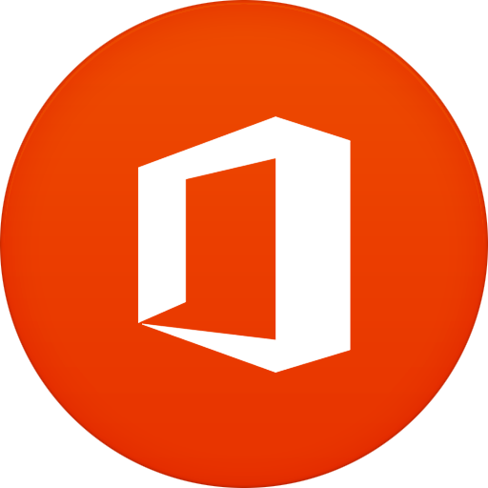
Saas
G-mail
Microsoft Office 365
With Software as a Service (SaaS), everything is managed
Examples:

Slide 44
Main DevOps clouds
Google Cloud Platform
Microsoft Azure
Amazon Web Services

