Slide 1
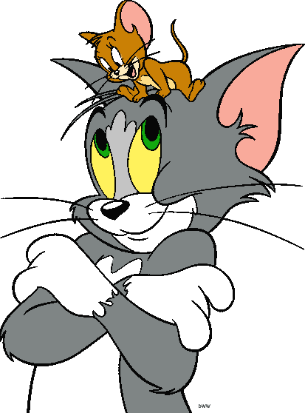
Comparatives

Slide 2
What do you think? Answer the questions.
Who is smaller?
Jerry is smaller than Tom.

Slide 3
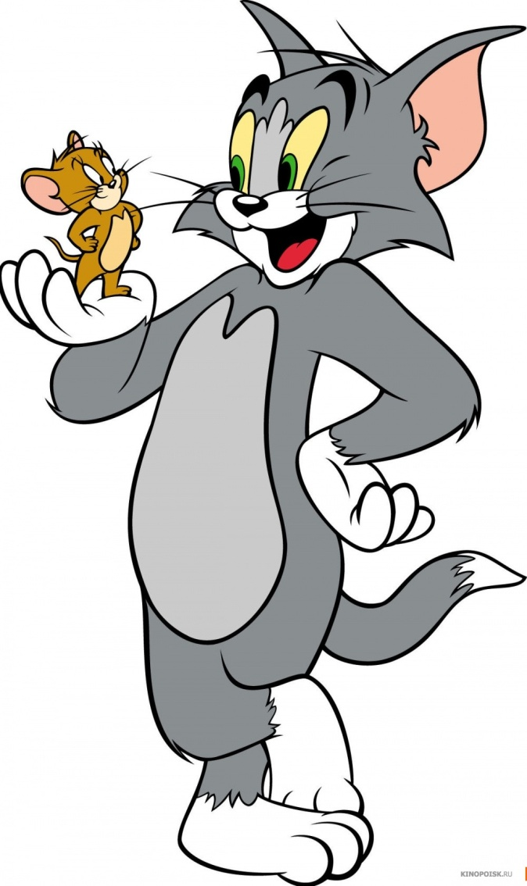
What do you think? Answer the questions.
Who is taller?
Tom is taller than Jerry.

Slide 4
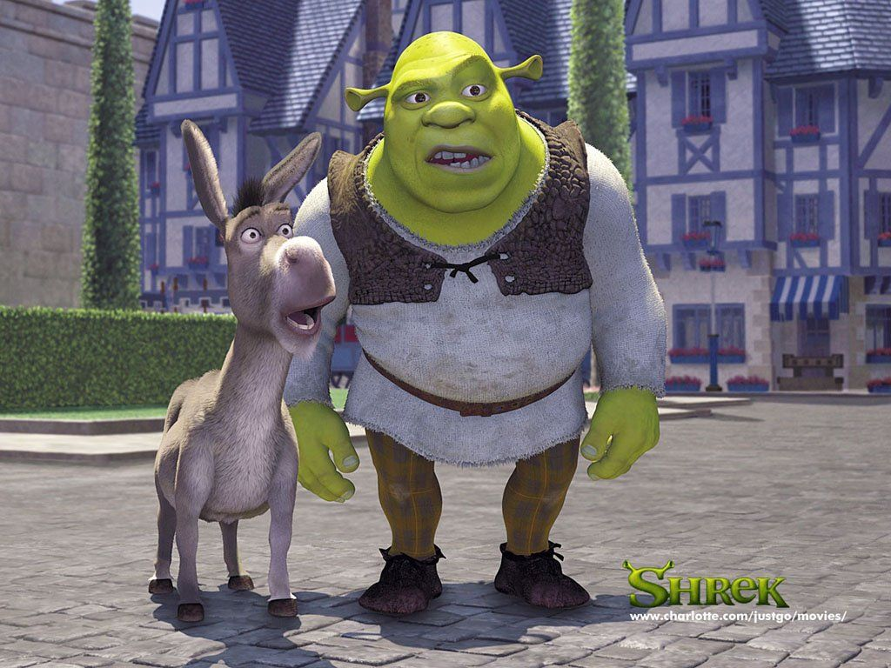
What do you think? Answer the questions.
Who is bigger?
Shrek is bigger than Donkey.

Slide 5
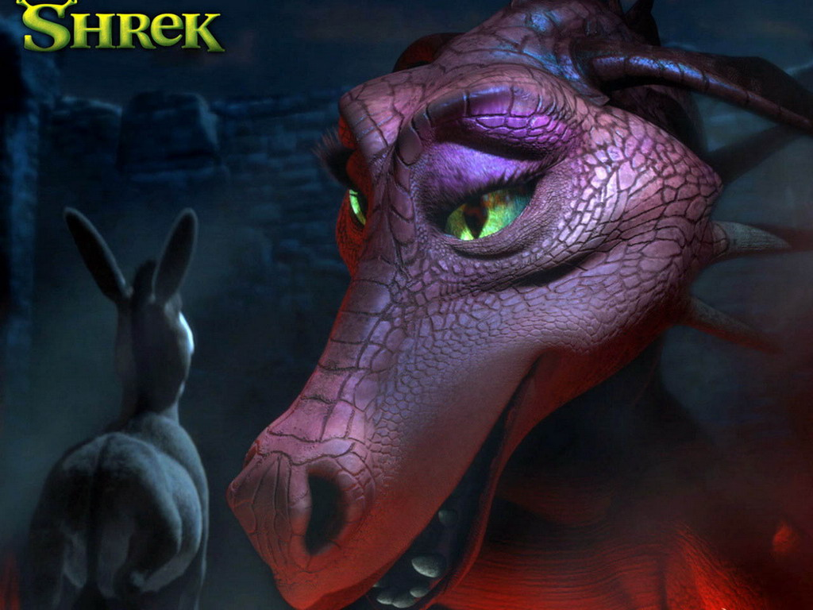
What do you think? Answer the questions.
Who is more beautiful?
Dragon is more beautiful than Donkey.

Slide 6
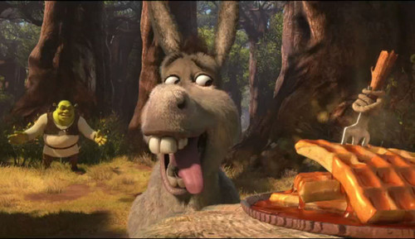
What do you think? Answer the questions.
Who is hungrier?
Donkey is hungrier than Shrek.

Slide 7
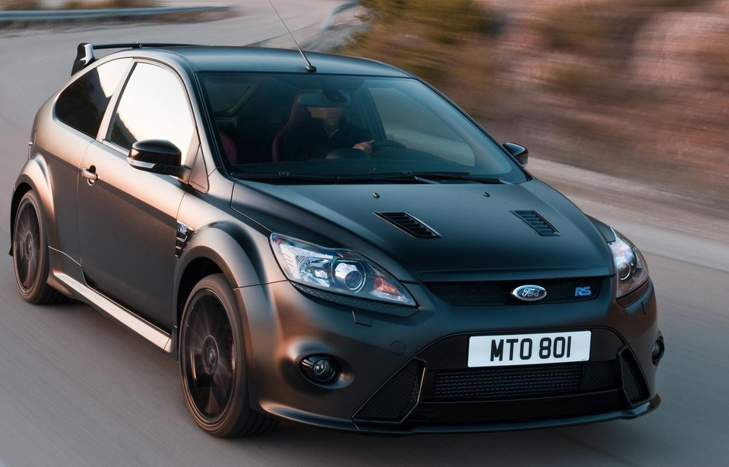
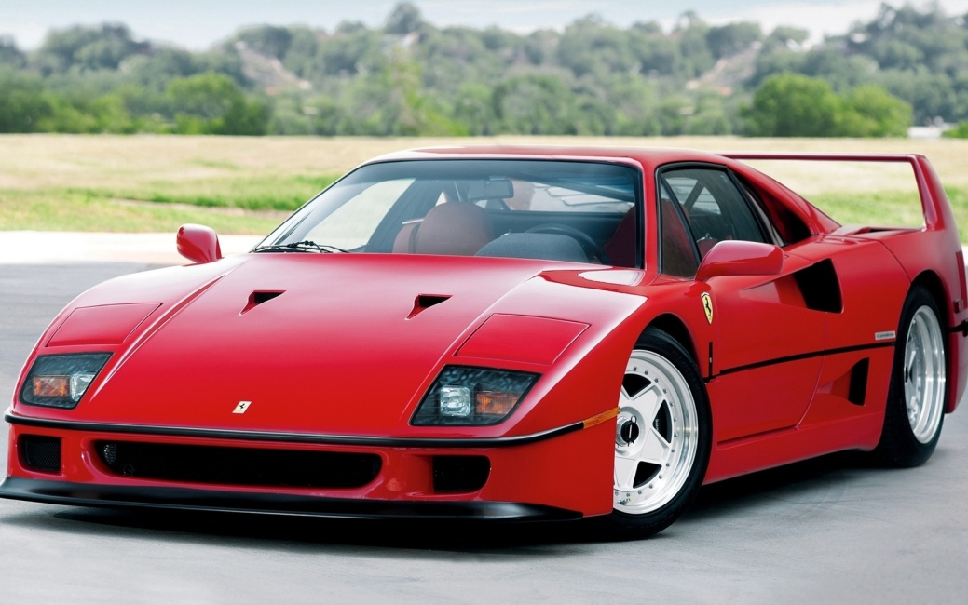
What do you think? Answer the questions.
Which car brand is more expensive?
Audi is more expensive than Ford Focus.

Slide 8
bigger
big
 | slower
interesting | more interesting
 | hotter
bad
 | better
attentive
nice
slow
hot
little
less
worse
good
more attentive
dirty
dirtier
nicer

