Slide 1
Topic Agile и RUP – myths, legends and all true
Course
Information System Development and Deployment
Kovaliuk Tetiana
Igor Sikorsky KPI

Slide 2
Agile – это ИНОЙ менеджмент.
<
Процессный. А как это?
Agile-RUP и Agile-MSF –существуют.
Что такое RUP*? Что такое MSF?
Ценности Agile – и все получится?
“XP/Agile/SCRUM – это не методология” (да? – нет?)
myths, legends and all true
*) RUP – IBM Rational Unified Process
MSF – Microsoft Solution Framework

Slide 3
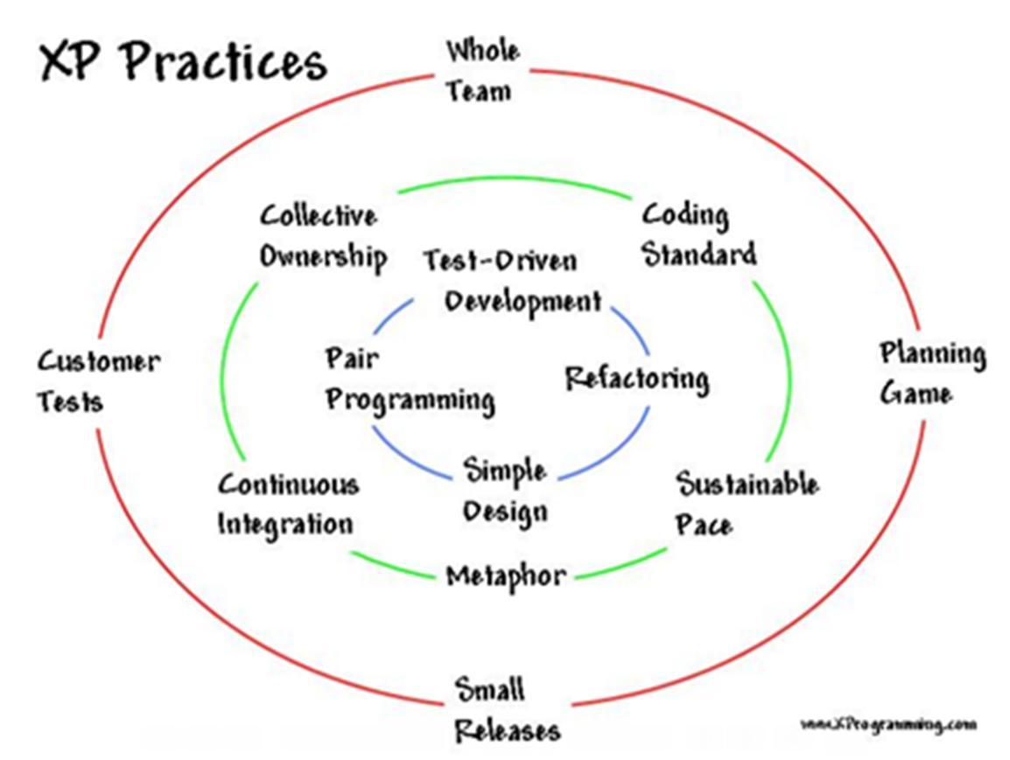
ХР
<

Slide 4
Три принципа
<
ПРОЗРАЧНОСТЬ: «Сопровождение» Внешних и Внутренних коммуникаций
ИНОЙ менеджемент – Доверие и самоорганизация
«КУРАЖ» - … утром хочется на работу

Slide 5
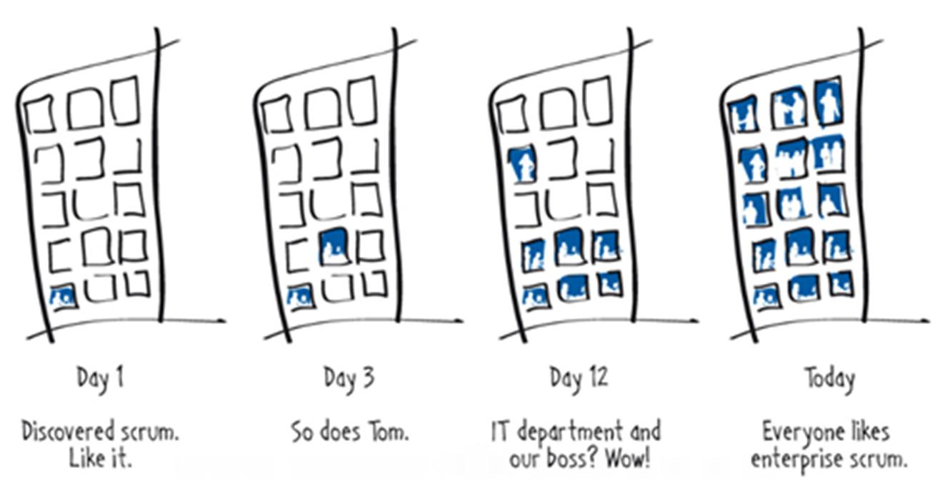
Эволюция Agile в организации
<

Slide 6
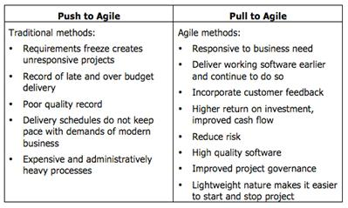
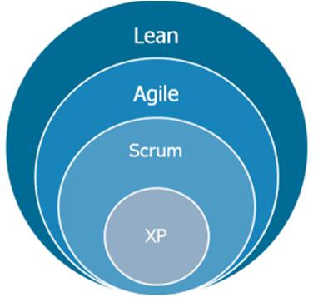
Преимущества для Бизнеса
<

Slide 7
XP / Agile / SCRUM - 2
<
Agile is a set of values
• Individuals/Interactions
• Working software
• Customer collaboration
• Responding to change
• and twelve principles
http://agilemanifesto.org/principles.html
FROM: Tobias Mayer A short introduction to Scrum and its underlying Agile principles

Slide 8
XP / Agile / SCRUM - 1
<
• SCRUM is not a Methodology
• SCRUM is a Framework
for surfacing organizational dysfunction
• SCRUM doesn’t provide answers –
It helps you ask better questions
• SCRUM doesn’t actually do anything –
People do things
FROM: Tobias Mayer A short introduction to Scrum and its underlying Agile principles

Slide 9
XP / Agile / SCRUM - 3
<
• Scrum is an Agile framework that allows you
to create your own lightweight process
for developing new products
Scrum will help you fail in 30 days or less
• Scrum is simple
It can be understood and implemented in a few days. -
It takes a lifetime to master
• “Scrum is not a methodology - – it is a pathway”
– Ken Schwaber (Boulder, Co, Nov. 2005)
FROM: Tobias Mayer A short introduction to Scrum and its underlying Agile principles

Slide 10
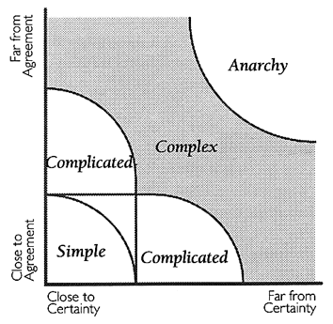
XP / Agile / SCRUM - 4
<
 | Scrum works best when the problems to be solved lie in the Complex Space. New Product Development Work and Knowledge Work both tend to exist in the Complicated Space. Research lies in the Anarchy space Maintenance lies in the Simple Space
Technology – on X axis
Requirements - on Y axis ref: The Stacey Diagram, by Ralph Stacey
FROM: Tobias Mayer A short introduction to Scrum and its underlying Agile principles

Slide 11
XP / Agile / SCRUM - 5
<
The Scrum Foundation:
• Empiricism
• Self-organization
• Collaboration
• Prioritization
• Time Boxing
FROM: Tobias Mayer A short introduction to Scrum and its underlying Agile principles

Slide 12
XP / Agile / SCRUM - 6
<
Empiricism
Detailed up-front planning and defined processes are replaced by just-in-time inspect and adapt cycles
Self-organization
Small teams manage their own workload and organize themselves around clear goals and constraints
Collaboration
Scrum leaders, product visionaries and customers collaborate with developers – they do not manage or direct them
FROM: Tobias Mayer A short introduction to Scrum and its underlying Agile principles

Slide 13
XP / Agile / SCRUM - 7
<
Prioritization
Work on the most important thing – do not waste time focusing on work that does not add immediate value
Time Boxing
Time boxing creates the rhythm that drives development
FROM: Tobias Mayer A short introduction to Scrum and its underlying Agile principles

Slide 14
Add immediate value
<

Slide 15
XP / Agile / SCRUM - 8
<
With a SOLID FOUNDATION…
your process, your design and your product will emerge in the way most appropriate to your context
Emergence
The beauty of letting go, and trusting
FROM: Tobias Mayer A short introduction to Scrum and its underlying Agile principles

Slide 16
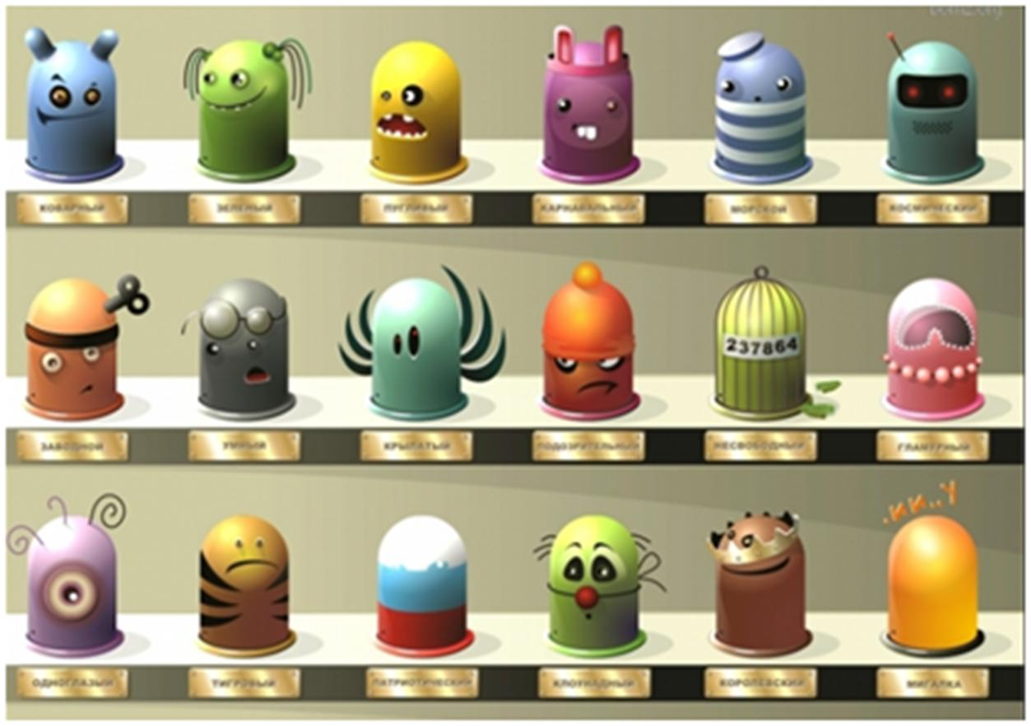
Scrum People
<

Slide 17
XP / Agile / SCRUM - 9
<
Scrum People:
Product Owner - Thought Leader & Visionary
Scrum Master - Trouble Shooter & Servant Leader
The Team
FROM: Tobias Mayer A short introduction to Scrum and its underlying Agile principles

Slide 18
XP / Agile / SCRUM - 10
<
Product Owner - Thought Leader & Visionary Drives the Product Vision Maintains the Product Backlog Prioritizes the Requirements Accepts the Working Software | The Team 5-8 Members Cross-Functional Self-Managing Autonomous Accountable for Meeting Commitments
Scrum Master - Trouble Shooter & Servant Leader Manages the Process Supports the Team Removes Organizational Impediments Socializes Scrum to Management | Vision Statement A short statement of intent A goal to aspire to
FROM: Tobias Mayer A short introduction to Scrum and its underlying Agile principles

Slide 19
Vision Statement
<

Slide 20
XP / Agile / SCRUM - 11
<
Product Backlog A living list of requirements Represents the WHAT of the system Prioritization is essential ! | Planning Occurs at the start of each sprint Team and PO negotiate the commitment THEN - The team members begin the design process and generate tasks
Design versus Delivery Deliver the highest value early on But don’t neglect the bigger picture Allow design and architecture to emerge | Growing tree is a good metaphor for building the right thing From sapling to full oak tree, the plant must deliver business value from the start to feed itself
FROM: Tobias Mayer A short introduction to Scrum and its underlying Agile principles

Slide 21
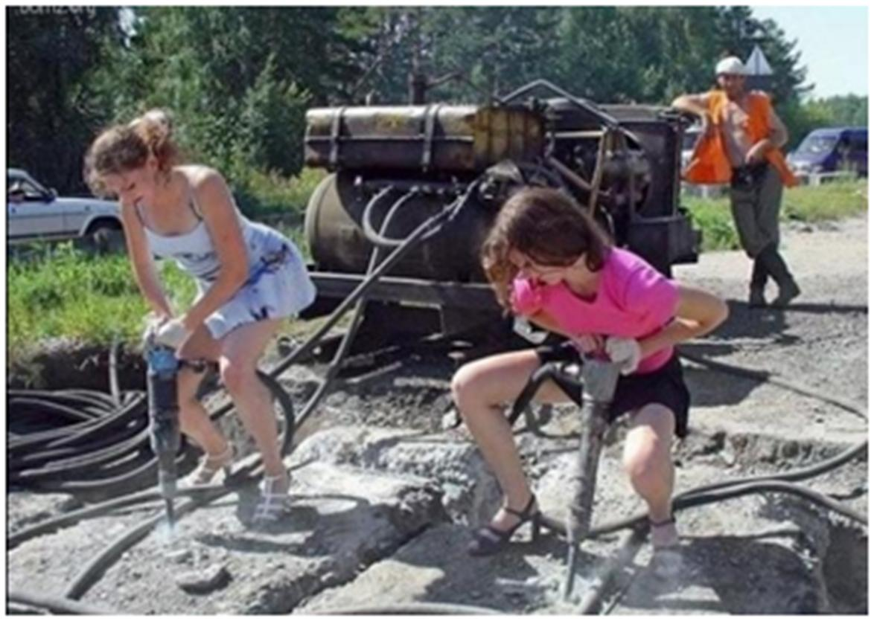
Scrum Execution
<

Slide 22
XP / Agile / SCRUM - 12
<
Scrum Execution:
Sprint Backlog
Daily Scrum
Story Burndown / Team Task Board
“Done” - Working Software
FROM: Tobias Mayer A short introduction to Scrum and its underlying Agile principles

Slide 23
XP / Agile / SCRUM - 13
<
Sprint Backlog
A list of tasks representing the HOW of the system
The Sprint Backlog is owned and managed by the Team
Daily Scrum - 15 Minutes | 3 Questions
What did you do since the last Daily Scrum?
What will you do by the next Daily Scrum?
What is getting in your way?
FROM: Tobias Mayer A short introduction to Scrum and its underlying Agile principles

Slide 24
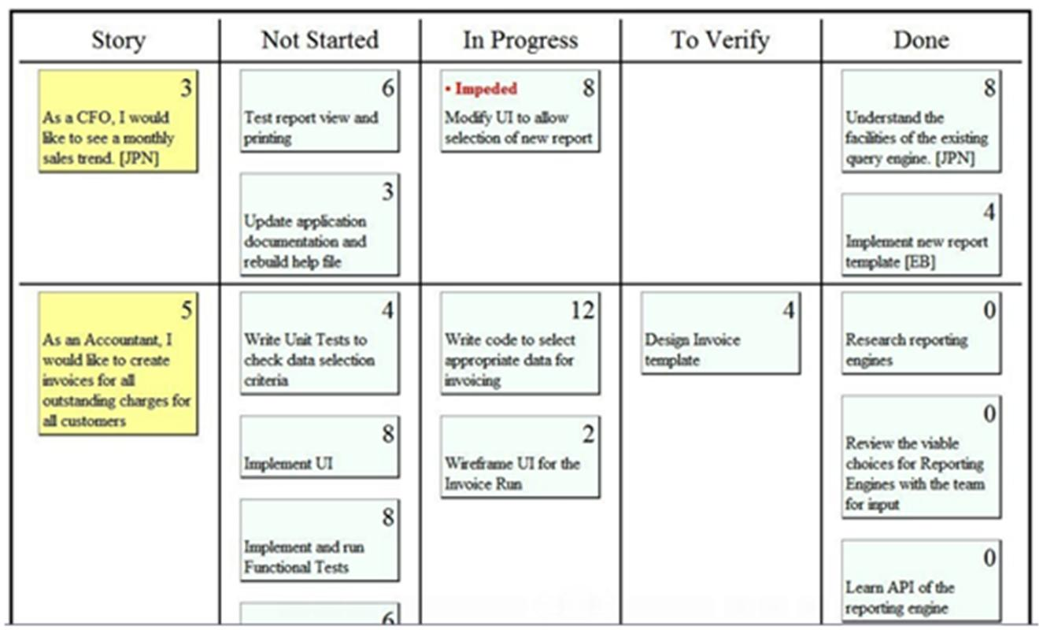
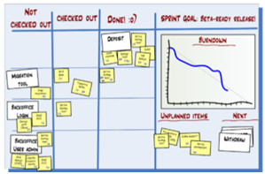
Story Burndown / Team Task Board
<

Slide 25
XP / Agile / SCRUM - 14
<
“Done” - Working Software
Example checklist for working software
Unit tests pass
Customer Acceptance tests pass
User docs written
UI design approved by PO
Integrated into existing system
Regression tests pass
Deployed on staging server
FROM: Tobias Mayer A short introduction to Scrum and its underlying Agile principles

Slide 26
XP / Agile / SCRUM - 15
<
Bugs - There are two types of bug recognized in a Scrum:
Bugs found on a story in the current iteration
Write a task for that bug and put it in “To Do” List
These are fixed as they are found
Story is not “Done” until all tasks are complete
Bugs found outside an iteration, e.g. at the Review Meeting
These simply become new stories, are put into the backlog and prioritized by the PO
FROM: Tobias Mayer A short introduction to Scrum and its underlying Agile principles

Slide 27
XP / Agile / SCRUM - 16
<
Review
Occurs at the end of each sprint
Inspect and Adapt the product
The team meets with the Product Owner and the Stakeholders to demonstrate the working software from the sprint
Retrospective
Occurs at the end of each sprint
Inspect and Adapt the process
The team meets with the Scrum Master to look at what went well and what can be improved
Retrospectives must conclude with individual commitments to action
Impediment List
A list of organizational and team impediments – with suggested solutions - This list is maintained by the Scrum Master
FROM: Tobias Mayer A short introduction to Scrum and its underlying Agile principles

Slide 28
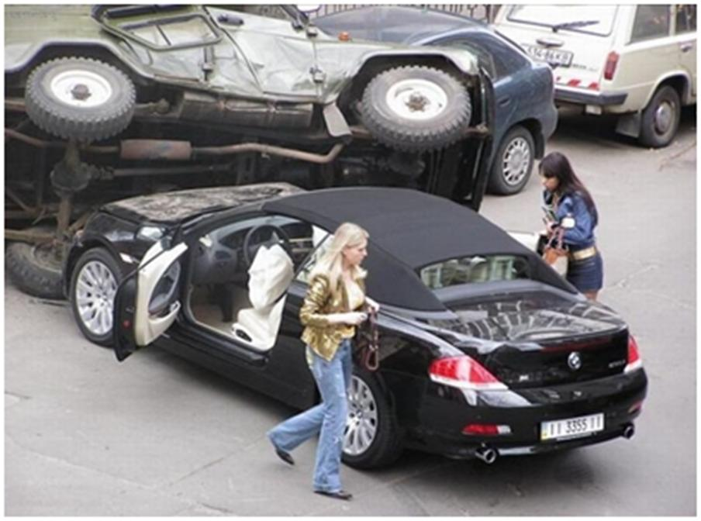
Scrum Reflection
<
Review
Retrospective
Impediment List

Slide 29
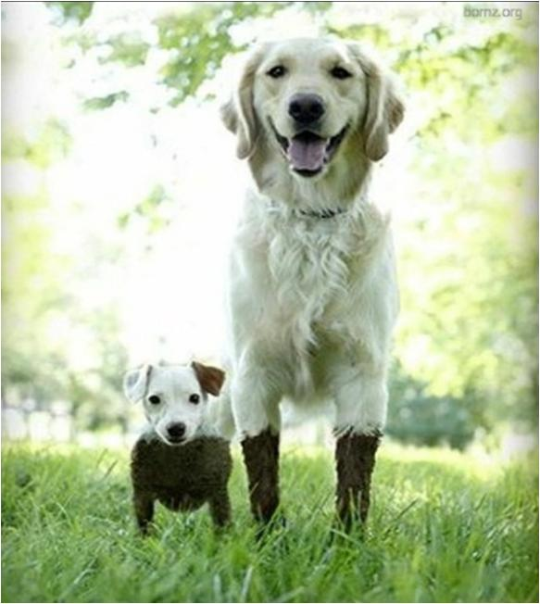
Agile / RUP
<
Сценарий использования / История пользователя

Slide 30
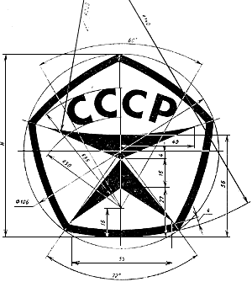
Agile / RUP
<
Хорошие сценарии использования
Должны:
Приносить значимый результат
Содержать все вариации
Описывать взаимодействие и механизмы, но не политики
Не быть зависимыми от технологий и интерфейсов
Быть достаточно крупными
Инициироваться только одним актером
Включать основные бизнес-исключения и их обработку

Slide 31
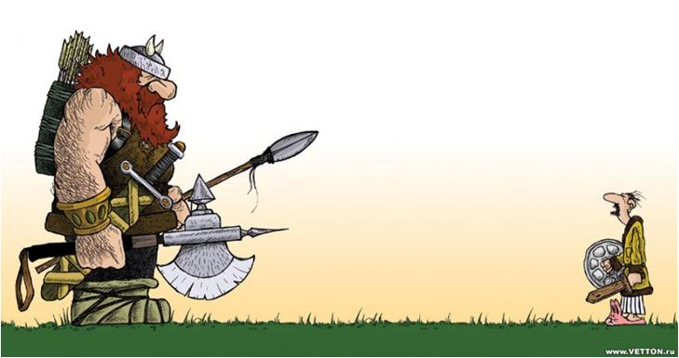
Agile / RUP
<
Модель сценариев использования
Имеет четыре компонента:
Границы системы
Актеры
Сценарии использования
Отношения
Представляет собой не только диаграмму!

Slide 32
Agile / RUP
<
Истории пользователей –
короткое описание функциональности, которая нужна пользователям для достижения их бизнес-целей.
Конкретные нужды конкретного пользователя, выраженные в простой форме.
Одно или два предложения с указанием:
Актера – кто будет использовать историю
Описания истории – высокоуровневый обзор функциональности
Выгоды – бизнес-ценность результатов работы истории

Slide 33
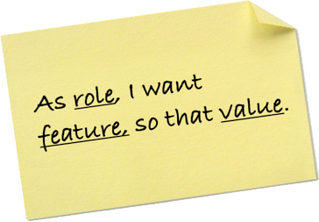
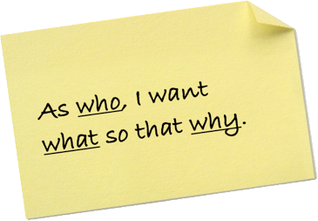
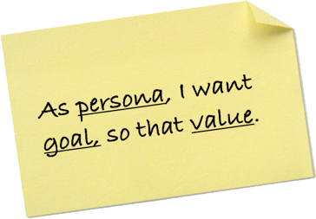
Agile / RUP
<
Шаблон истории пользователя
Как <тип пользователя> я хочу <сделать> и тем самым получить <выгоды>

Slide 34
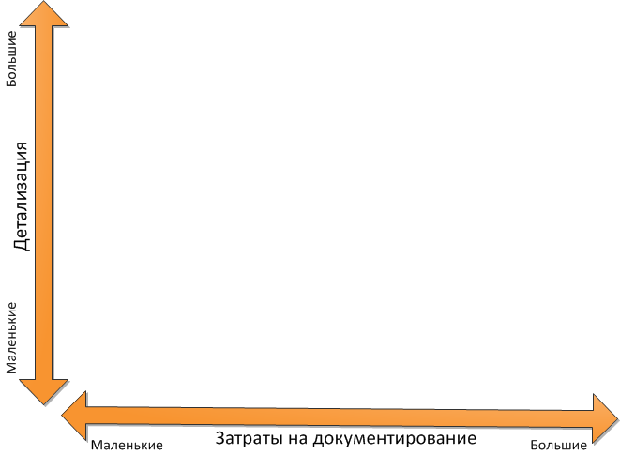
Agile / RUP
<
Сравнение: Уровень детализации
Истории пользователей
Краткое описание сценария
Неформальные сценарии
Формальные сценарии использования

Slide 35
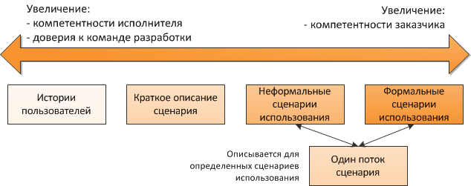
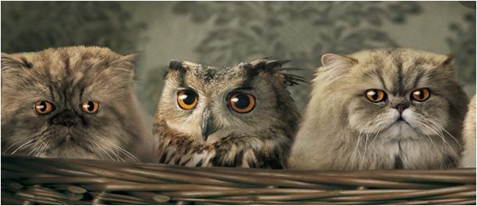
Agile / RUP
<
Сравнение: Компетентность и доверие

Slide 36
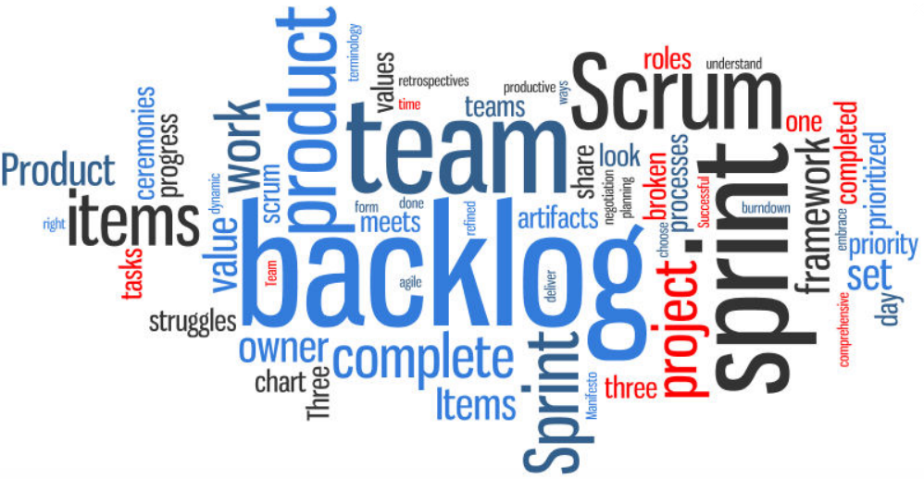
Подводим Итоги
<

Slide 37
XP / Agile / SCRUM
<
Scrum Values
Courage
Trustfulness
Transparency
FROM: Tobias Mayer A short introduction to Scrum and its underlying Agile principles

Slide 38
Три принципа
<
ПРОЗРАЧНОСТЬ: «Сопровождение» Внешних и Внутренних коммуникаций
ИНОЙ менеджемент – Доверие и Самоорганизация
«КУРАЖ» - … утром хочется на работу

Slide 39
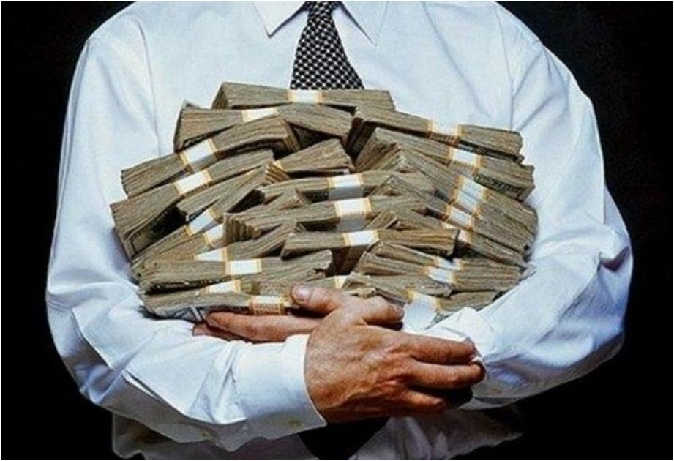
Вопросы?
<

