Slide 1
Meals and Cooking

Slide 2
Hello!
My name is Fluffy and I absolutely love food!
So my friends and me want to tell you something about it.

Slide 3
How do you think what verbs in bold mean?
When we cook, we
boil,
roast,
fry our food.

Slide 4
We boil in a cooking pot
eggs, meat, chicken, fish, milk, water and vegetables.

Slide 5
We fry in a pan
eggs, fish, meat and vegetables.

Slide 6
We stew in multicooker fish, meat, vegetables.

Slide 7
We roast
meat or chicken.

Slide 8
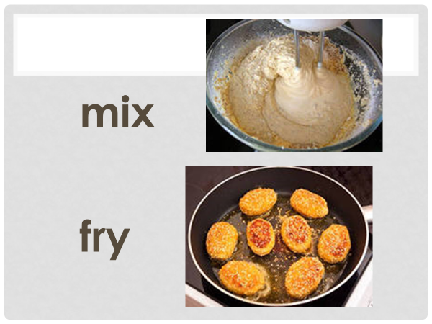

Slide 13
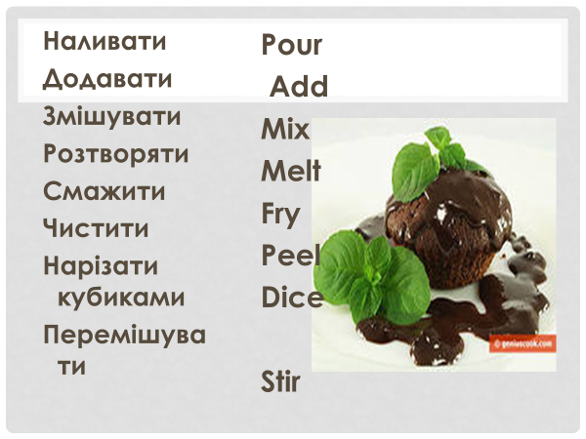

Slide 14
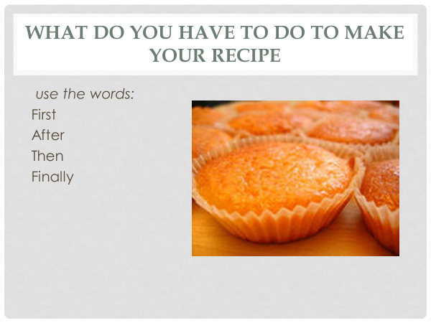

Slide 15
Recipes

Slide 16
Hi!
I’m glad too see you again!
And today I want to tell you how to cook my favorite dish!

Slide 17
Breakfast Pepperoni Pizza
Chopped – нарубленный;
a crust – корочка;
shredded cheese – тертый сыр;
slices pepperoni - острая копченая колбаса пеперони;
a baking sheet – лист для выпечки.

Slide 18
Ingredients
2 eggs
1 green onion, chopped
2 teaspoons water
1 teaspoon butter
1 prebaked mini pizza crust
1/3 cup shredded cheese
1/4 cup pizza sauce
12 slices pepperoni

Slide 19
Method
1.First in a small bowl, beat the eggs, onion and water. Then in a small pan, heat butter until it’s hot. Add egg mixture; cook and stir over medium heat.
2. After that place the crust on a baking sheet. Add about 2 tablespoons cheese and about 2 tablespoons pizza sauce. Then put egg mixture. Finally add pepperoni on over the top.

Slide 20
Bake about 10-12 minutes.
Let it stand for 5 minutes before serving.

Slide 21
Write the recipe of your favorite dish using next instructions:
Name of dish
Ingredients
Total time cooking
Method.
Use sequence words!

