Slide 1
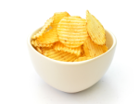
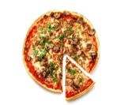
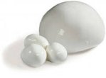
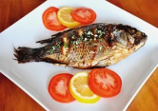
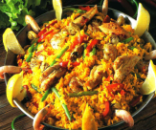
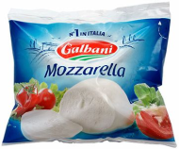
ALL AROUND THE WORLD
All around the world
People love to eat.
All around the world
Food is such a treat.
Fish and chips is English,
Sushi’s Japanese.
Pizza is Italian,
So is mozzarella cheese!
In Spain they eat paella,
In China they eat rice.
The Russians think potatoes
Are really, really nice.

Slide 2
TODAY WE WILL TALK ABOUT
FOOD
REVISE THE FOOD-WORDS
SOME /ANY/a /an
MAKE UP THE DIALOGUES
DO SOME EXERCISES

Slide 3
Food and Drinks

Slide 4
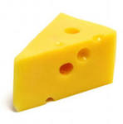
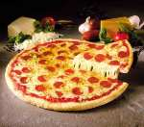
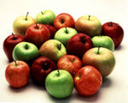
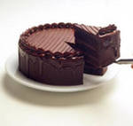
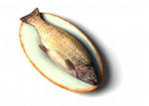
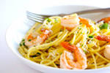
Choose items from the picture and act out a dialogue (вибери слова та зроби діалог)
A: Do you like fish?
B: Yes, it’s delicious. / No, it’s horrible.

Slide 5
Some/any/a/an
a-перед приголосним звуком( однина.)
an- перед голосним звуком(ед.ч)
some-
any-
+
множина
-
?
I have a cat
She has an atlas
I have some fruits
She hasn’t any fruits

Slide 6
Complete using some/any/a/an: ( доповни)
1. There's_______ airport next to the city.
2. There are_____ postcards on this table for you.
3. Are there_____ parents in that party?
4. There's____ house next to the river
5. There are_____ good books that you should read.
6. Are there_____ chocolates in the kitchen?

Slide 7
What is the odd word out? (Прибири зайве)
Main Courses
Desserts
Starters
Restaurant
OOPS!
WELL DONE!
WRONG!
TRY AGAIN!

Slide 8
What is the odd word out? (Прибири зайве)
Main Courses
Desserts
Starters
Restaurant
OOPS!
WELL DONE!
WRONG!
TRY AGAIN!

Slide 9
What is the odd word out? (Прибири зайве)
Cola
Orange Juice
Milk Shake
Apple Pie
OOPS!
WELL DONE!
WRONG!
TRY AGAIN!

Slide 10
What is the odd word out? (Прибири зайве)
Cola
Tea
Lemonade
Sprite
OOPS!
WELL DONE!
WRONG!
TRY AGAIN!

Slide 11
Fruits
Vegetables
Drinks
Others
cheese | fish
honey | meat
water | tea
coffee | milk
potatoes | juice
apples | bananas
cake | carrot
tomatoes | onions

Slide 12
Перевір себе!
an Some any A Some any

